Slide 1
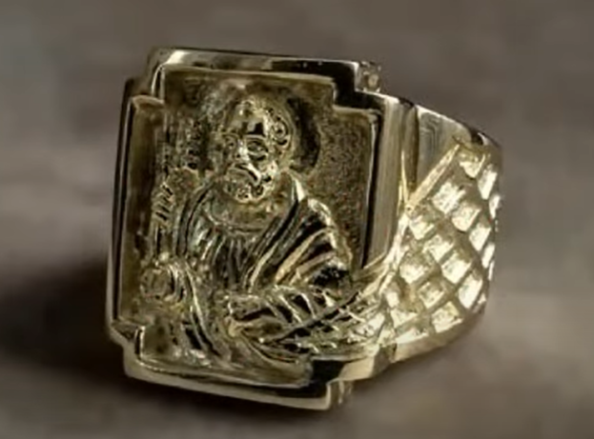

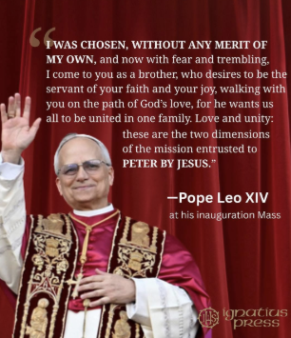
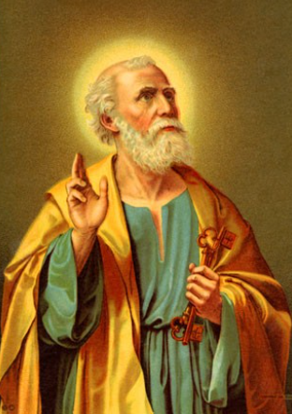
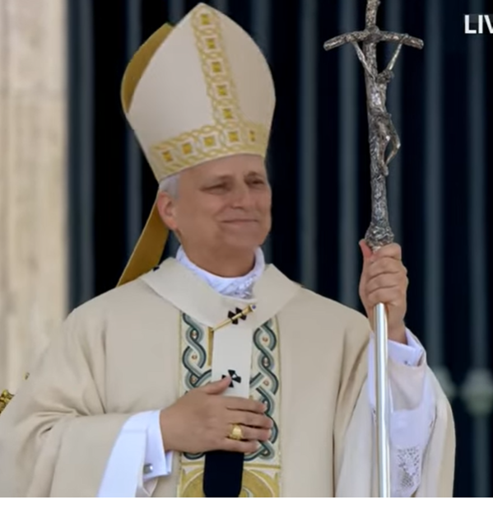
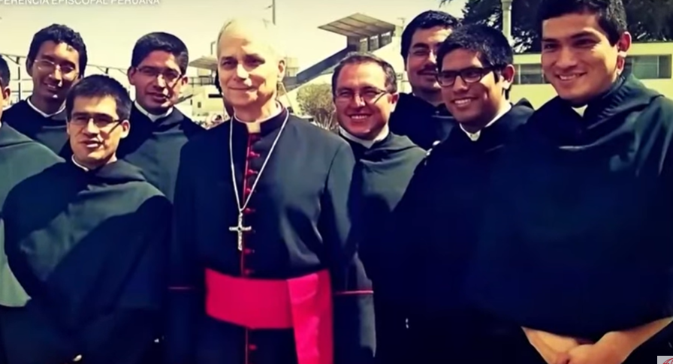
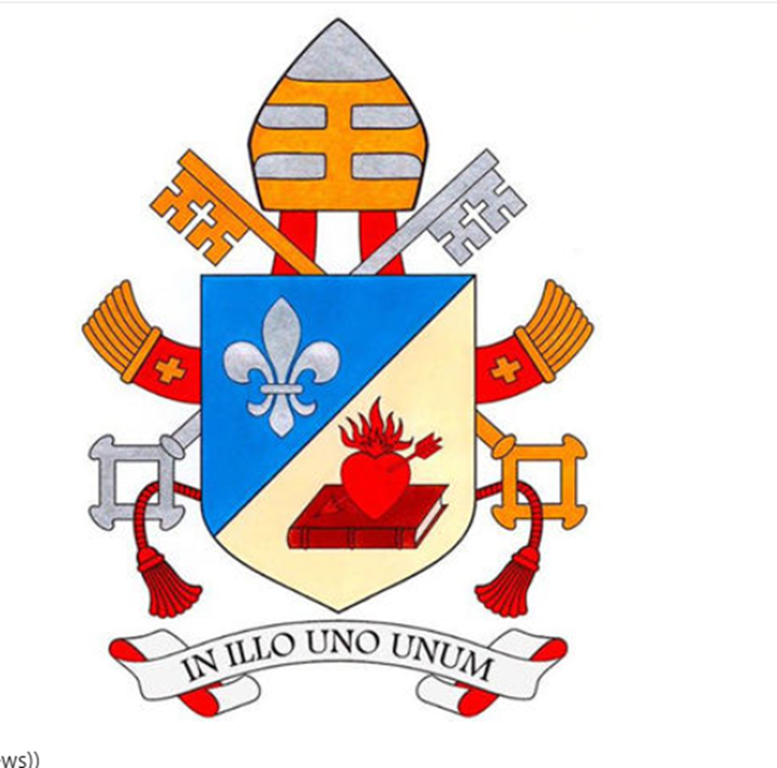
The inauguration Mass of Pope Leo XIV
Sunday 18th May 2025
Robert Francis Prevost
Matthew 16: 18-19.
“And so I tell you, “You are Peter, and upon this rock, I will build my Church, and the gates of hell shall not prevail against it. I will give you the keys of the kingdom of heaven. Whatever you bind on earth shall be bound in heaven; and whatever you loose on earth shall be loosed in heaven.”

Slide 2

The Coat of Arms of Pope Leo XIV
The upper half features a white lily on a blue background, representing the Virgin Mary. Some suggest it could also be seen as a reference to the French influence in his home state of Illinois and family roots in Louisiana.
The lower half of the shield has a 'light background' and displays an image of a closed book and a heart pierced by an arrow – a reference to Saint Augustine, who described how the Word of God pierced his heart.
Pope Leo XIV has also chosen a motto that reflects the Augustinian tradition: 'In Illo uno unum', which means 'In the One, we are one', from Saint Augustine’s Exposition on Psalm 127.

