Slide 1
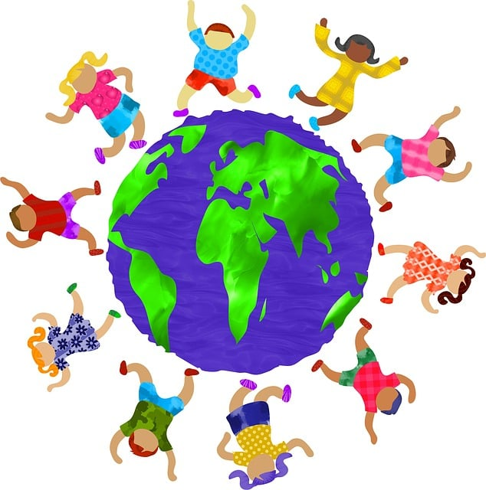

Racial Justice Sunday 2025
Notes:
Welcome the pupils and staff and explain that Racial Justice Sunday is taking place on the 16th February across England and Wales.
It is an important day for Catholics to reflect on racial justice and commit to making a difference.

Slide 2

What does it mean to be ‘just’ or fair?
What do we mean by the ‘Church’?
Before we begin…
Notes:
What does it mean to be ‘just’ or fair?
Being "just" or "fair" means treating everyone equally and respectfully. It’s about making decisions that are right and honest, no matter who the person is. It’s about standing up for what is right and ensuring everyone gets the same respect and opportunities.
What do we mean by the ‘Church’?
The Church is not just a building—it’s all the people who follow Jesus and try to live like Him.
The Church is like a big family of people who believe in God and want to do what He teaches.
We call it the Body of Christ because Jesus is like the head, and we are all the different parts working together to share His love.
The Church is also where we come to pray, worship, and celebrate special things like Baptism and Holy Communion. These are called sacraments and are ways we get closer to God.
So, when we say "the Church," we mean all the people around the world who love God and help each other live like Jesus!

Slide 3

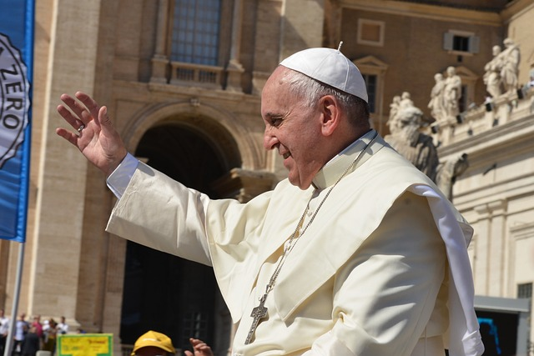
Notes:
What is a Jubilee Year?
In the Catholic Church, a Jubilee or Holy Year is a special year of forgiveness and reconciliation, in which people are invited to come back into right relationship with God, with one another, and with all of creation.
Pope Francis has given us the theme “Pilgrims of Hope” as it is to be a year of hope for a world.

Slide 4

Pilgrims of Hope:
Our Journey Together Towards Racial Justice.
Why is this important?
Notes:
The Bishops of England and Wales have linked the theme of Racial Justice Sunday to the Jubilee Year:
Pilgrims of Hope: Our Journey Together Towards Racial Justice.
Explain that a pilgrim is someone on a journey, guided by faith and hope.
Emphasise that as a school community, we are on a journey together towards a fairer, more inclusive world.

Slide 5
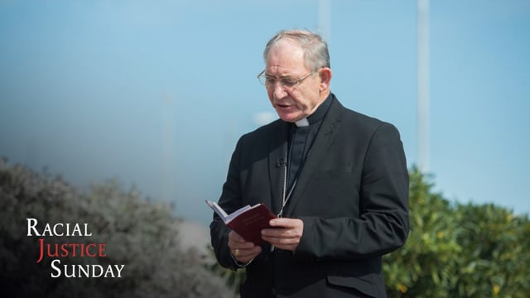
Video from Bishop Paul McAleenan
Bishop McAleenan's message for Racial Justice Sunday 2025
Notes:
Play the video message – you may wish to use this element only for Key Stage 2 depending on whether the assembly is used as a whole school or in phases.

Slide 6
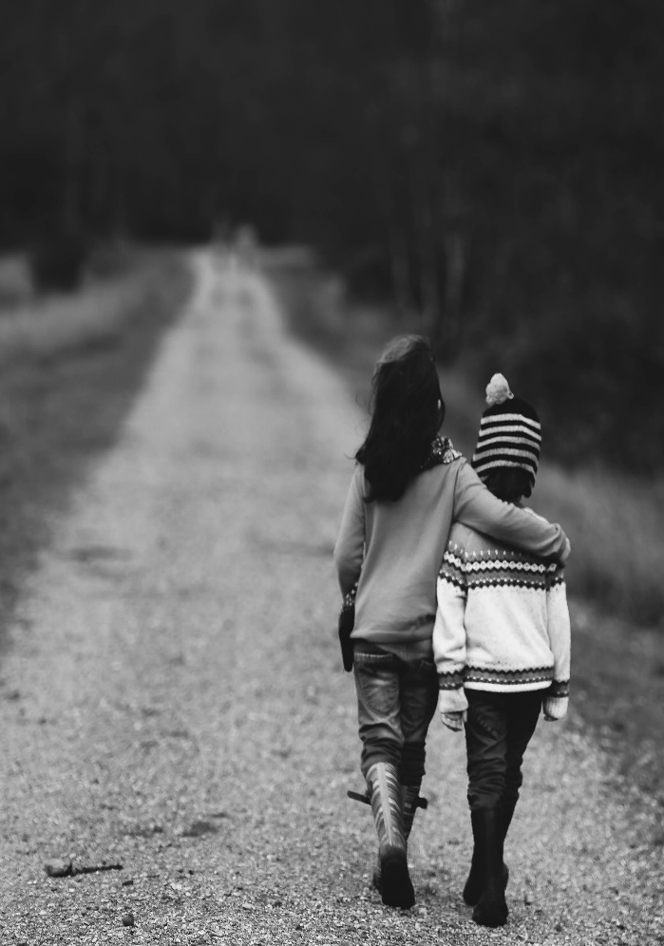
Move forward with faith and courage, even in difficult times.
Work together as a community.
Keep their eyes on the goal: justice, equality, and love for all.
What does it mean to be pilgrims of hope?
Notes:
Explain what it means to be pilgrims of hope -
As pilgrims, we don’t have all the answers, but we walk forward with hope, guided by our faith.
Hope gives us the courage to tackle big issues like racism and inequality, even when it feels challenging.
Emphasise the importance of journeying together.
Racial justice is not something one person can achieve alone-it takes everyone working as a community, no matter your race or background.

Slide 7
Do I show love and respect to people from different backgrounds?
Are there times when I have stayed silent about unfair treatment instead of speaking up?
What can I do to make our school community a place of kindness and fairness?
Silent Reflection
Notes:
Having considered the theme for Racial Justice Sunday and the scripture reading, read each of these questions and encourage children to silently reflect on them.

Slide 8
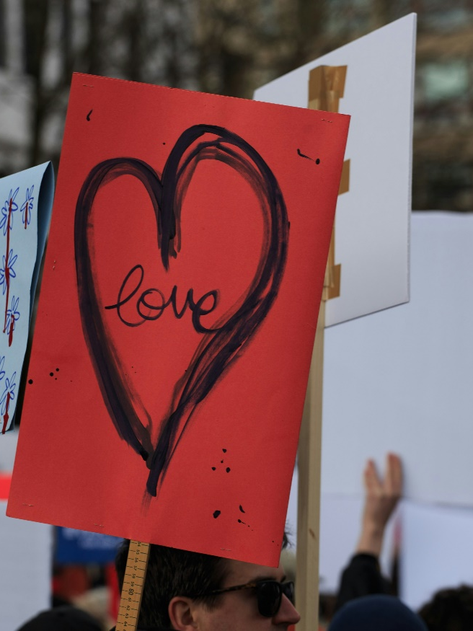
"You shall love your neighbour as yourself"
(Matthew 22:39)
What did Jesus say?
Notes:
Prayerfully share and reflect on this line from scripture. Perhaps read it slowly several times, asking the children to consider who their neighbour is each time. Think of someone it is easy to be a neighbour for and maybe someone who we don’t always treat as a neighbour.
Explain that
Jesus calls us to love our neighbours as we love ourselves.
Neighbours means everyone not just those who live near us.
And Jesus is saying that just as we look out for and look after ourselves, we must look out for and look after other people.
Highlight that
This includes people of every race, culture, and background.
Loving our neighbour means standing up against unfair treatment and working for a world where everyone feels included and valued.
Relate the verse to the theme:
As pilgrims of hope, our journey is guided by love - love for all our neighbours, especially those who have been treated unfairly because of their race.

Slide 9
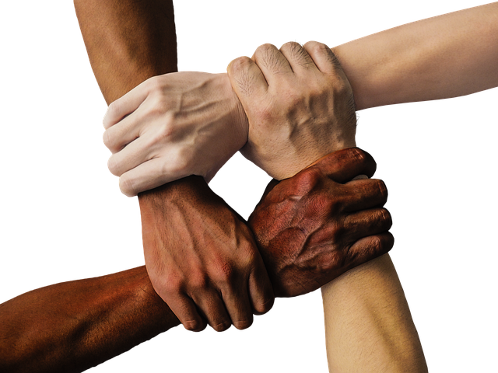
As Pilgrims of Hope:
Speak out when you see someone being treated unfairly.
Be a friend to someone who feels left out or different.
Learn more about other cultures and traditions.
Mission
Notes:
Explain that
Being pilgrims of hope means taking action, not just thinking about change.
Speaking out takes courage, but it helps others feel supported.
Being a friend creates a sense of belonging.
Learning about different cultures shows respect and builds understanding.
Encourage students to choose at least one of these actions to practise this week.
As a class or a pupil leadership groups, perhaps choose one of these actions or another and include it in your Jubilee Year Pledge.

Slide 10

Closing Prayer
Notes:
God of Justice and Peace, You call us to walk together as pilgrims of hope, guiding our steps with love, truth, and compassion. Help us to stand against racism in all its forms and to celebrate the beauty of our diversity. May our journey towards racial justice bring healing and unity to our world. Through Christ our Lord.
In the name of the Father, and of the Son, and of the Holy Spirit, Amen.

