Slide 1
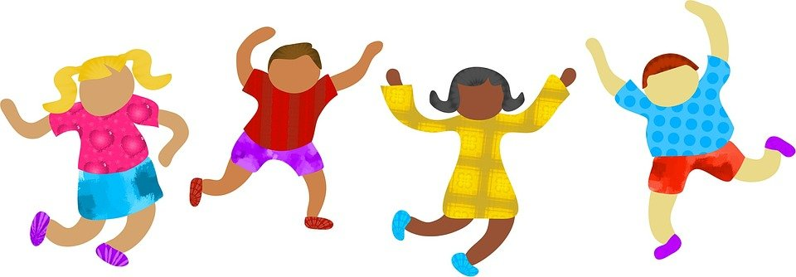

Racial Justice Sunday 2024

Slide 2
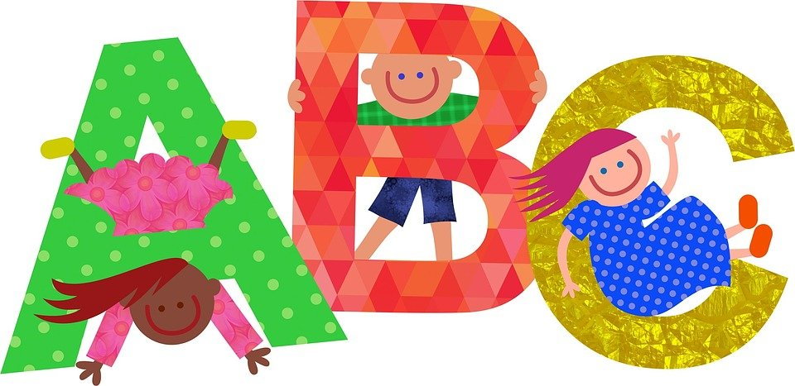
What does it mean to be ‘just’ or fair?
What do we mean by the ‘Church’?
Before we begin…

Slide 3
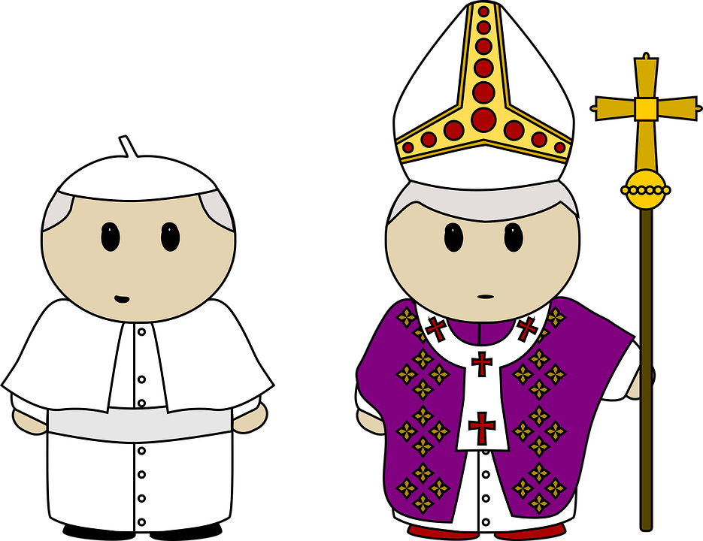

See one another in the life of the Church.
This year the bishops in our country said that we should
Think: Why is this important?

Slide 4

Lord, as we gather together,
we thank you for creating us in your image and likeness. Help us to remember that we are all your children, regardless of our race. May we see you in all the people we meet. Thank you for the saints of every race and culture who show us how Jesus wants us to live. Help us to follow their example and to work for your Church so that all are loved and welcomed.
In Jesus’ name, we pray. Amen.
Gather

Slide 5


Unlike the scribes, he taught them with authority
Jesus and his disciples went as far as Capernaum, and as soon as the sabbath came he went to the synagogue and began to teach. And his teaching made a deep impression on them because, unlike the scribes, he taught them with authority.
In their synagogue just then there was a man possessed by an unclean spirit and it shouted, ‘What do you want with us, Jesus of Nazareth? Have you come to destroy us? I know who you are: the Holy One of God.’ But Jesus said sharply, ‘Be quiet! Come out of him!’ And the unclean spirit threw the man into convulsions and with a loud cry went out of him. The people were so astonished that they started asking each other what it all meant. ‘Here is a teaching that is new’ they said ‘and with authority behind it: he gives orders even to unclean spirits and they obey him.’ And his reputation rapidly spread everywhere, through all the surrounding Galilean countryside.
Listen (Mark 1:21-28)

Slide 6
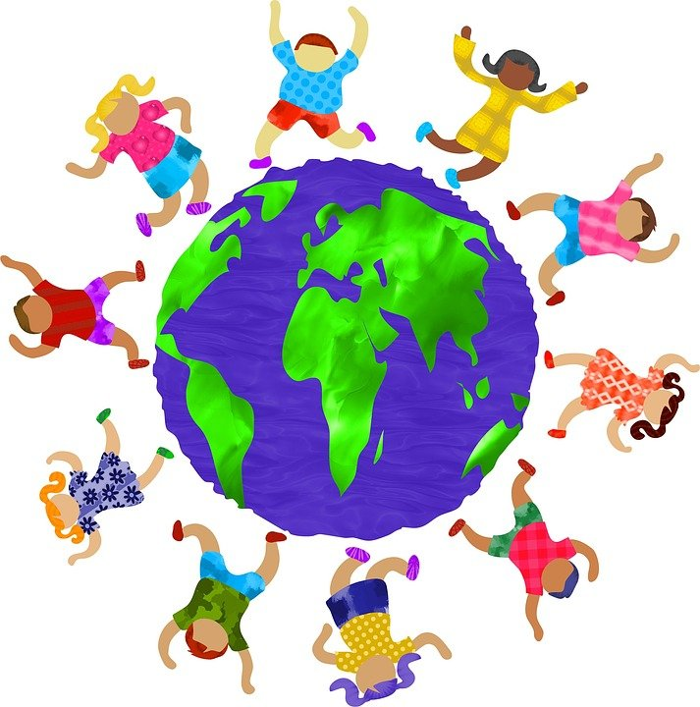
Do you obey Jesus? Do you obey his teaching to love one another?
How can you contribute to the life of the Church?
How can you help to make sure that everyone feels included and welcome?
Let’s close our eyes and Reflect

Slide 7
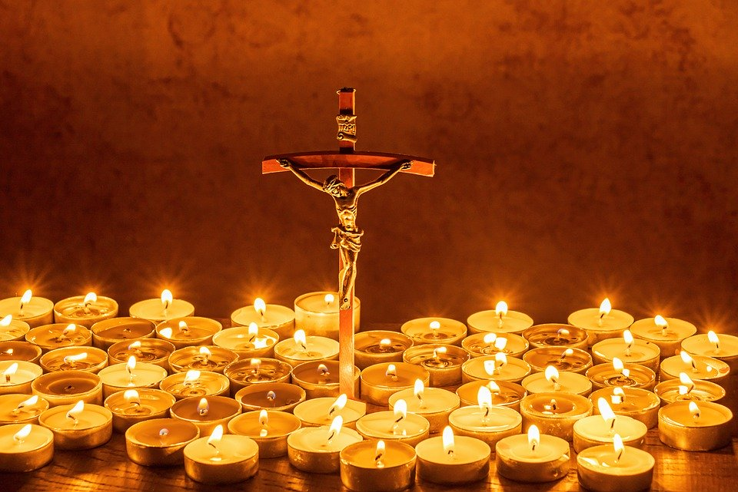
Let us pray

Slide 8
1. We pray for people of all races, that they will be treated kindly and fairly.
Lord hear us…
2. We pray for those who feel hurt or sad because of unfairness or racial injustice.
Lord hear us…

Slide 9
3. We pray for the leaders in our country and in our Church that they will act now to bring about change for the better.
Lord hear us…
4. We pray for each one of us, that we can all work together so we can see all races, including our own, in the life of the Church.
Lord hear us… Our Father…

Slide 10

Now: Complete an activity from the pack based on the theme and then live this out in your life:
Seeing one another in the
life of the Church.
We will be creating a school display and then send a photo to our Diocesan Advisor
Mission – back in class…

Slide 11

Video message from Mr Johnson
https://stmaryscs-my.sharepoint.com/personal/h_malik-brown_stmarys_net/_layouts/15/stream.aspx?id=%2Fpersonal%2Fh%5Fmalik%2Dbrown%5Fstmarys%5Fnet%2FDocuments%2FAttachments%2Fmr%20johnston%20video%2Emp4&nav=eyJwbGF5YmFja09wdGlvbnMiOnt9LCJyZWZlcnJhbEluZm8iOnsicmVmZXJyYWxBcHAiOiJTdHJlYW1XZWJBcHAiLCJyZWZlcnJhbFZpZXciOiJwb3N0cm9sbC1jb3B5bGluay0xIn19&ga=1&referrer=StreamWebApp%2EWeb&referrerScenario=AddressBarCopied%2Eview

