Slide 1
Year of the Word
March theme

Slide 2
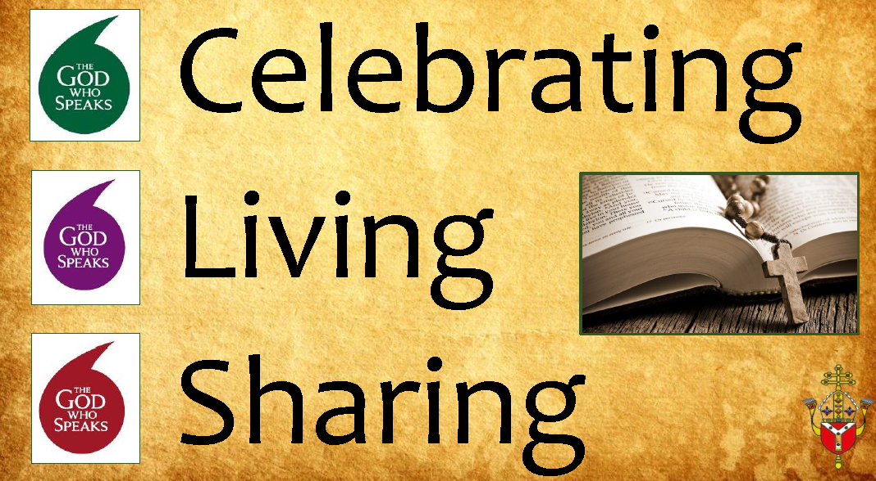
What is the Year of the Word
The aim of this year is to help us learn more about the Bible which is the word of God and how we can spread his mission
We must listen to the Bible and share the Good news with others
The Year of the word will help us become closer to Jesus and love each other through Bible messages
We are the scripture champions and will help you each month to focus on different themes linked to the Bible

Slide 3

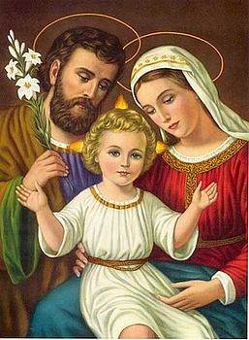
Prayer
Notes:
Lottie

Slide 4
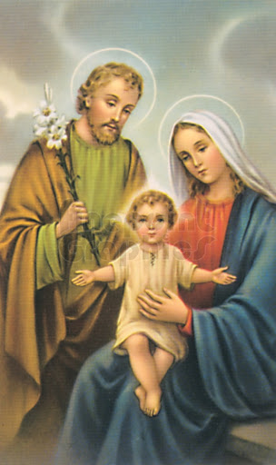
This months theme is the Holy Family
Notes:
Amelia

Slide 5
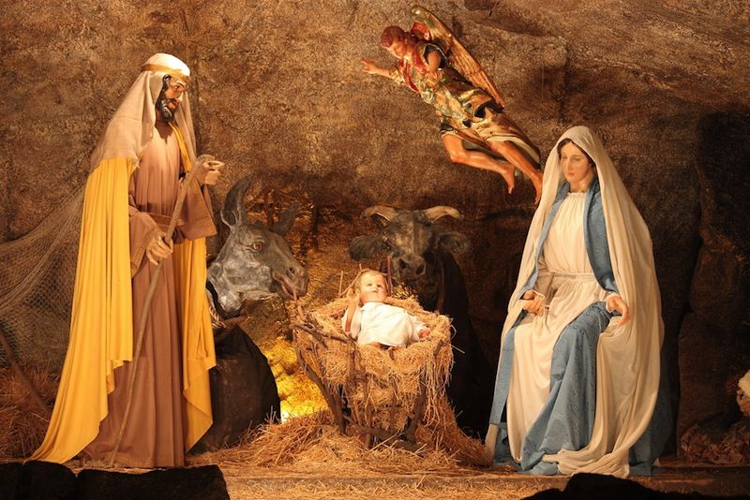
The Birth of Jesus
Notes:
Ana-Rose

Slide 6
What does this story mean?
Notes:
Madison

Slide 7
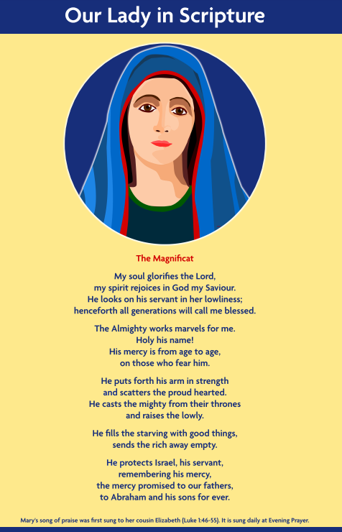
25th March -Feast of the Annunciation

Slide 8
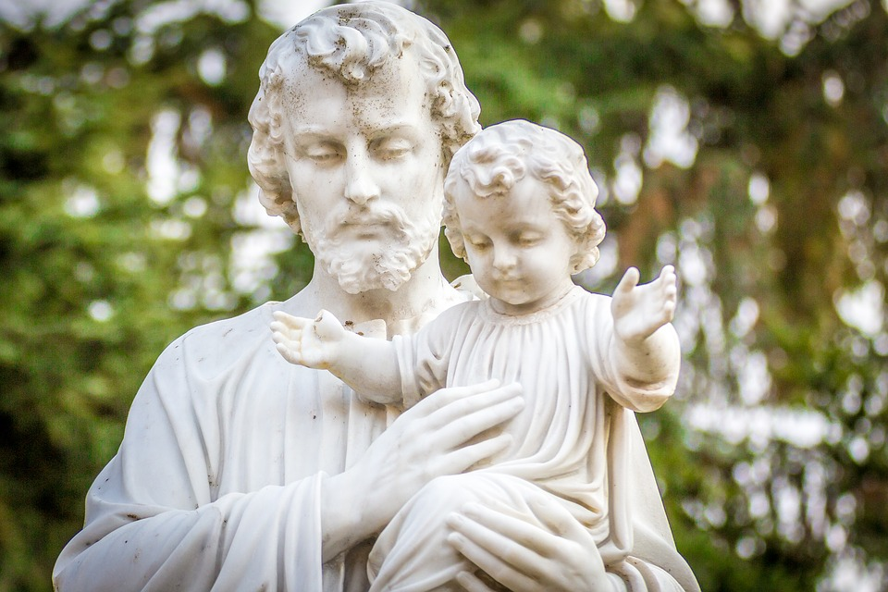
The Year of St Joseph

Slide 9
Your mission this month
Notes:
Jonny

Slide 10

How can you be like the Holy Family?
On this template draw and write how you can be like the Holy Family.
Notes:
Jonny

