Slide 1
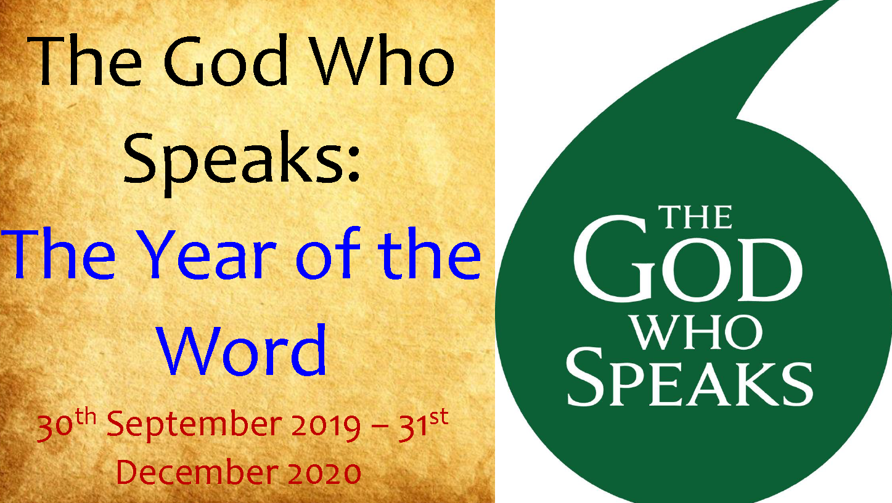
The Year of the word

Slide 2
What is the Year of the Word
We are in a special year at the moment called the Year of the Word
The aim of this year is to help us learn more about the Bible which is the word of God
We must listen to the Bible and share the Good news with others
The Year of the word will help us become closer to Jesus and love each other through Bible messages

Slide 3
Scripture champions
The scripture champions will make an assembly each month about the monthly focus for the Year of the Word
We will also be helping the whole school learn about the Bible
We will also be helping you learn about the Year of the Word and understanding of the Bible

Slide 4
October theme
Each month there is a special theme to help us learn more about The Year of the Word
This months theme is focused on Saint Jerome
St Jerome is the patron saint of translators and scholars
He translated the Bible into Latin, the common language of his day so that people could read the Bible and find out about the Good News.
This was important because other people could understand it and read it. People spoke mostly Latin.
To celebrate St Jerome’s Feast day (30 September) and the 1600th anniversary of his death, our theme this month is on Bible translation – how Bible translators work and how the Bible is translated into art.

Slide 5
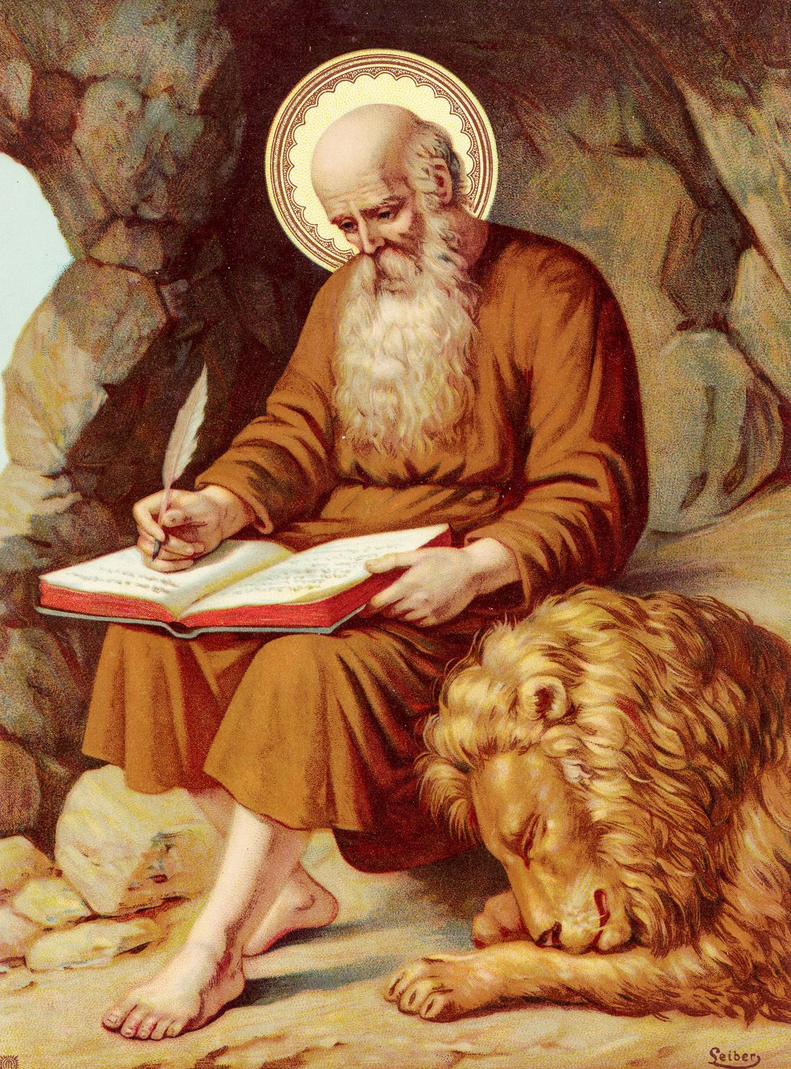
Saint Jerome
Facts about St Jerome from Ana-Rose

Slide 6

Your mission
On one side you can write down a message from the Bible – what have you learnt from it?
On the other side write down or draw and label how you will share and live out this message

Slide 7
Prayer
Read by scripture champions

Slide 8
Thank you for listening

