Slide 1
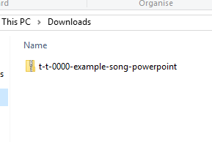
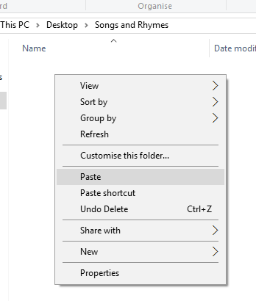


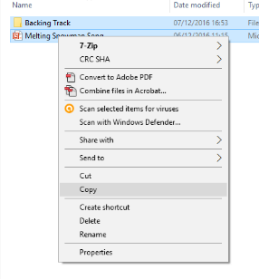
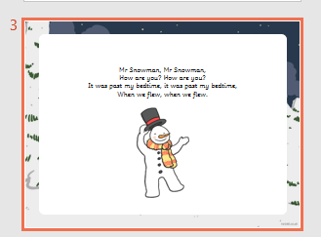
Guidance for Video/Audio in PowerPoints
1. Open the folder and copy all the files.
2. Paste the copied files into a new folder.
3. Open the PowerPoint file, enable editing and enter presentation mode (start the slide show). Go to slide 3 and the backing track will start automatically.
Please note the embedded audio may not be compatible with early versions of PowerPoint.
You may wish to delete this slide before beginning the presentation.

Slide 3
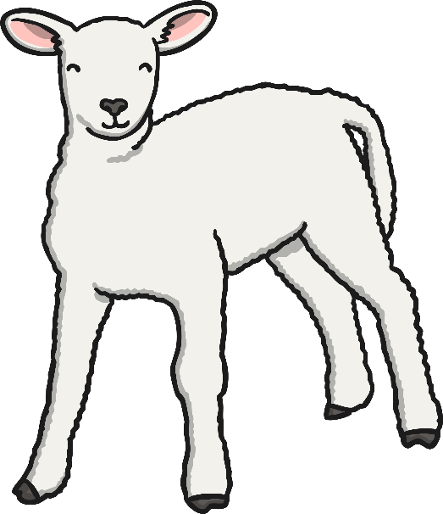




In the springtime, sun and rain,
Green leaves on the trees again.
Baby an-i-mals are born,
In the ponds there is frogspawn.
In the springtime, sun and rain,
Green leaves on the trees again.

Slide 4


In the springtime, flowers grow,
In the sky see a rainbow.
Birds are singing in the trees,
Can you hear the buzzing bees?
In the springtime, flowers grow,
In the sky see a rainbow.

Slide 5


In the spring, March, April, May,
Getting warmer every day.
After winter, comes the spring,
Plants and flowers are growing.
In the spring, March, April, May,
Getting warmer every day.

