Slide 1
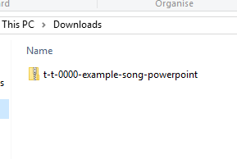
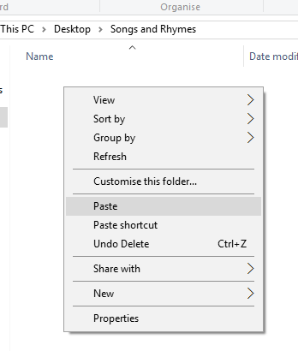

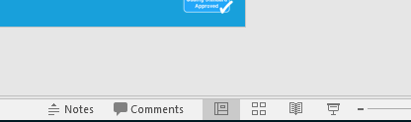
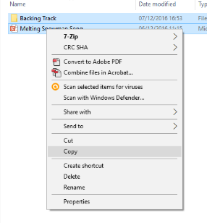
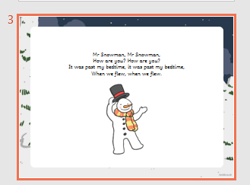
Guidance for Video/Audio in PowerPoints
1. Open the folder and copy all the files.
2. Paste the copied files into a new folder.
3. Open the PowerPoint file, enable editing and enter presentation mode (start the slide show). Go to slide 3 and the backing track will start automatically.
Please note the embedded audio may not be compatible with early versions of PowerPoint.
You may wish to delete this slide before beginning the presentation.

Slide 3




I see robins, I see birds’ nests,
Butterflies blue, flowers too.
Everything is growing, wind is gently blowing.
Spring comes through, growing new.

