Slide 1


Slide 2
What is happening this term
Tuesday and Wednesday afternoon, children will be split into groups where they will focus on Maths and Reading Comprehension.
The focus is to help build long-term memory, confidence and prepare for future topics.

Slide 3
Today’s topics that we will be covering
The layout of a comprehension paper
Possible strategies that the children can use
Completing a paper
Looking at the mark scheme

Slide 4
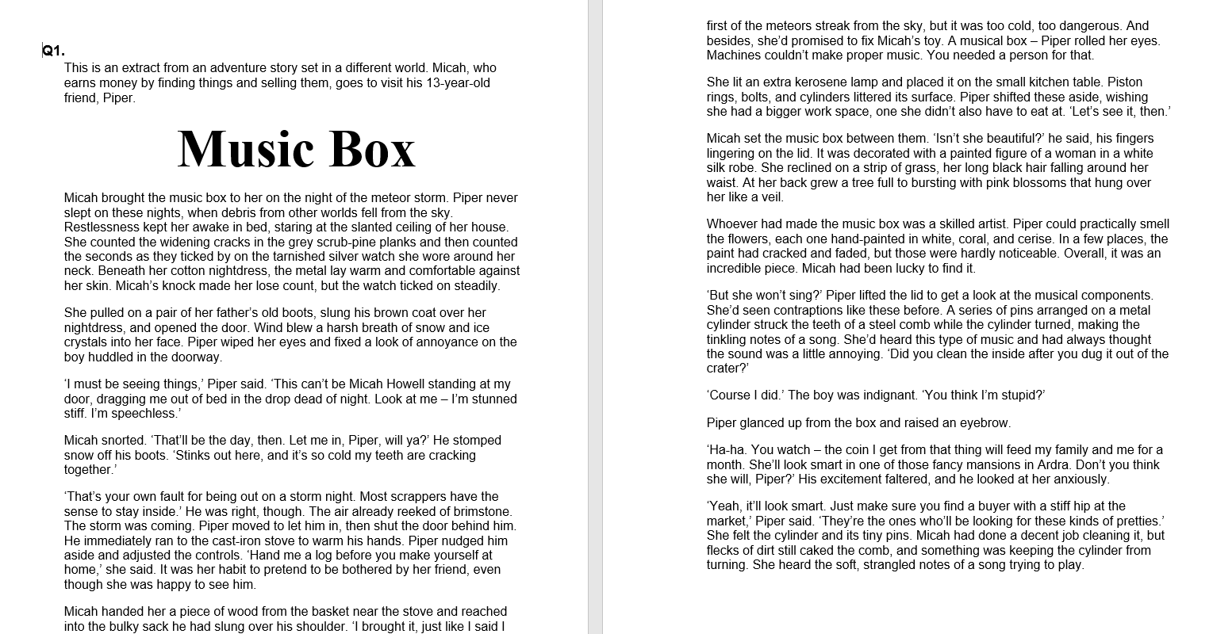

Slide 5
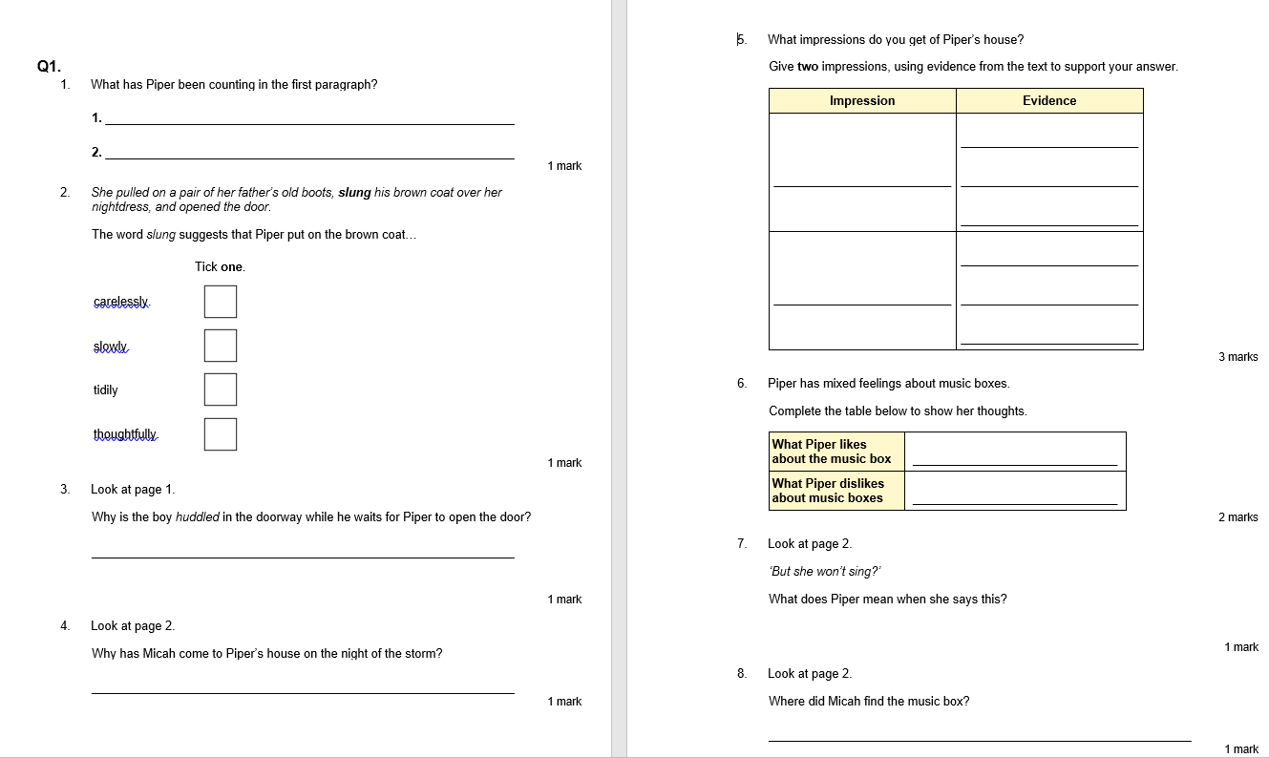

Slide 6
Strategies
Read the text first and then answer the questions
Read the questions and then the text (questions are in order of the text)
Start with the last text as it is the hardest and work backwards.
Highlight/underline key information that might be relevant.

Slide 7
LBQ
Pre-read
Inference
Retrieval
Features

Slide 8
2018 SATS Paper

