Slide 1

RSE in St Paul’s Catholic School
Wednesday 19th June 2024
Notes:
The

Slide 2
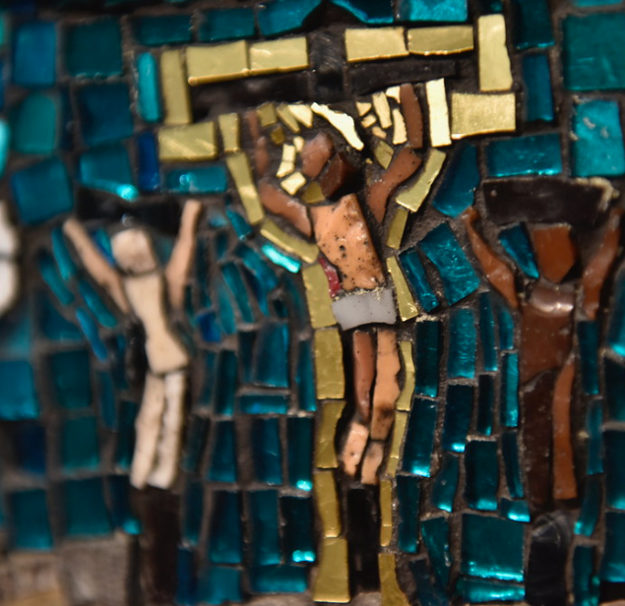
Prayer
Father,
Thank you for your great love for us. You sent your only Son to live with us and show us how to love.
As we explore teaching about relationships to the young people in our school, help us to keep them and Christ at the center of our minds.
May The Holy Spirit bring us wisdom and peace in guiding our conversations.
We commend to you our words and actions.
Amen
Notes:
The

Slide 3
Objectives:
To explore why RSE is important.
To share the statutory requirements of RSE.
To share the Curriculum and supporting documents from the Catholic Education Service.
To give and overview of the policy consultation process.

Slide 4

What was your experience of RSE?

Slide 5
What do you want for your children? What do your children need?

Slide 6
Why is RSE important?
Majority of parents support RSE.
Some parents say that RSE was the responsibility of parents, and that they welcome the right they have (enshrined in current law) to withdraw their child from Sex education lessons
Most of the young people disagreed, stressing that their parents have not in fact taught them!
Many parents/carers don’t discuss RSE as much as they wish to!
Notes:
Sex education forum survey 2011
Baroness Sheila Hollins Today’s teenagers, tomorrow’s parents: Connecting with young people in a complicated world – report to bishops is 2012
Research on young people in the church – one area explored was RSE.

Slide 7
Why is RSE important?
Research show that effective, honest, well-delivered sex and relationship education:
Delays a young person’s first experience of sex
Means they have fewer sexual partners
Reduces the chance of teenage pregnancy.
Abstinence only sex education programmes are not proved effective in these areas.
(Unesco – international technical guidance on sexuality education)
Notes:
Myth buster – RSE does not encourage Sexual activity
Baroness Sheila Hollins Today’s teenagers, tomorrow’s parents: Connecting with young people in a complicated world – report to bishops is 2012
Unesco - Why comprehensive sexuality education is important

Slide 8
The world in which they live
Social media
Celebrity culture & Media influences
Unrealistic body images –TV, advertising, online
AI and deep fakes
Access to pornography
Online safety & behaviour, sexting, vulnerability to grooming
Impact above all on children and young people’s attitudes, behaviour and values
Notes:
THAs well s the wonderful aspects of our world and the internet……

Slide 9
What we can offer through RSE:
Understanding their value and the values of others.
Instilling confidence and self-esteem.
Reliable, correct information in a safe learning environment
Knowing how to keep safe and how to get help.
Helping with peer pressure.
Learning how to make sensible and informed decisions in a changing cultural climate.
Understanding the positive impact of loving God, self, neighbour and our common home.
Notes:
THAs well s the wonderful aspects of our world and the internet……

Slide 10
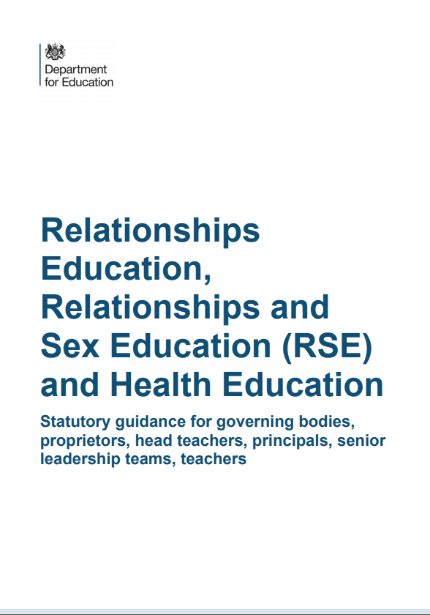
Statutory RSE
Notes:
THAs well s the wonderful aspects of our world and the internet……

Slide 11
Primary Relationships Education
Relationships Education will put in place the building blocks needed for positive and safe relationships, including with family, friends and online.
Your child will be taught what a relationship is, what friendship is, what family means and who can support them.
In an age-appropriate way, your child’s school will cover how to treat each other with kindness, consideration and respect.
By the end of primary school, pupils will have been taught content on:
• families and people who care for me
• caring friendships
• respectful relationships
• online relationships
• being safe
You can find further details by
searching ‘relationships, sex and health education’ on GOV.UK.
Notes:
tos

Slide 12
Primary Health Education
Health Education aims to give your child the information they need to make good decisions about their own health and wellbeing, to
recognise issues in themselves and others, and to seek support as early as possible when issues arise.
By the end of primary school, pupils will have been taught content on:
• mental wellbeing
• internet safety and harms
• physical health and fitness
• healthy eating
• facts and risks associated with drugs, alcohol and tobacco
• health and prevention
• basic first aid
• changing adolescent body
(The science curriculum in all primary schools also includes content on human development, including reproduction, which there is no right to withdraw from.)
You can find further details by
searching ‘relationships, sex and health education’ on GOV.UK.

Slide 13

Vision for Relationship and Sex Education in Westminster Catholic Schools
It is our vision for Relationship and Sex Education in Catholic Schools in the Diocese of Westminster that pupils would learn how to foster healthy relationships and friendships in light of the wisdom of the Church.
Pupils will flourish when they truly understand their innate human dignity, love and appreciation of themselves, including respect for their bodies, and the way they were made by God.
Pupils will learn to make sensible and informed decisions in a changing cultural climate, focussing on the virtues, such as patience and chastity, that ultimately lead to true happiness.
Sacred Scripture is key to this vision and the message Jesus gave us to love God, self, neighbour and our common home.
RSE in our schools must always remain faithful to the teaching of the Church, recognising the diversity of pupils’ situations. We aim to be sensitive to each individual, ensuring that their physical and emotional well-being and their safety are of paramount importance.

Slide 14
Catholic Education Service- RSE Documents
Model Curricula
Who is responsible for delivering RSE?
“RSE is part of the mission of Catholic schools to educate the whole person. It should be carried out as part of the holistic education which seeks to form as well as inform young people in preparation for adult life.” (CES)
Notes:
Parents at forefront!

Slide 15
Pedagogical principles
‘it must, above else, qualify as good education’.
Model Curriculum page 1

Slide 16
Differentiated
Cross curricular
Integrated
Coordinated
Balanced
Progressive and developmental
Notes:
th

Slide 17
Pedagogical principles
‘….Led to a deeper and fuller understanding by degrees at a rate which corresponds to their maturing’
Progressive and developmental
Notes:
Must qualify as good education
Like any good curriculum – planned and developmental. Appropriate to age and develops a deeper understanding as pupils mature.
Differentiated and ADAPTED. TRAINING UNDERTAKEN IF PARTICULAR NEED. SEN not withdrawn because of lack of resources or training.
Cross-teach the content where it is most appropriate.
PSHE, RE, SCIENCE ICT- EACH

Slide 18
Pedagogical principles
RSE is sensitive to the different needs of individuals and taught in a way that allows access to pupils at different stages of cognitive and emotional development’
Differentiated
Notes:
th

Slide 19
Pedagogical principles
‘Each discipline should speak with consistency about the meaning of human love and the virtues that are enshrined in the Church’s teaching on human love.’
Cross curricular
Notes:
th

Slide 20
Pedagogical principles
‘This can only be achieved if the home, parish and school work to integrate the teaching of RSE’
Integrated
Notes:
th

Slide 21
Pedagogical principles
None of these educational goals are possible if RSE is not given the time and importance it deserves by those who plan and implement its delivery in school. RSE must be taken seriously by school leaders; led properly by someone who has the time and expertise to co-ordinate the subject with dedication and commitment at a senior level; taught by those committed to doing it well; taught as part of a whole-school approach by those who are able to celebrate – not merely tolerate – the teaching of the Church on love and human sexuality.
Coordinated

Slide 22
Pedagogical principles
Whilst promoting Catholic virtues, schools should ensure that children and young people are offered a broad and balanced RSE programme which provides them with clear factual, scientific information when relevant and meets the statutory requirements placed on schools.
Balanced

Slide 23
Model Curricula
A model RSE Curriculum for Primary
A model RSE Curriculum for Secondary
3 themes
Created and loved by God
Created to love others
Created to live in community
Model Curriculum page 2

Slide 24
Created and loved by God
The Christian imperative to love self, made in the image and likeness of God, shows an understanding of the importance of valuing and understanding oneself as the basis for personal relationships.
Education in virtue
Religious understanding of the human person: loving myself.
Me, my body and my health
Emotional wellbeing and attitudes
Life cycles and fertility

Slide 25
Created to love others
God is love. We are created out of love and for love. The command to love is the basis of all Christian morality
Education in virtue
Religious understanding of human relationships: Loving others
Personal Relationships
Keeping Safe and People Who Can Help Me

Slide 26
Created to live in community
Education in virtue
Religious understanding of the importance human communities
Living in the wider world
Human beings are relational by nature and live in the wider community. Through our exchange with others, our mutual service and through dialogue, we attempt to proclaim and extend the Kingdom of God for the good of individuals and the good of society.

Slide 27
Education in Virtue
Each theme begins with a statement of the virtues which are necessary to living well in relationship with others and these virtues should underpin the teach habits which are learned from experiencing but also should emerge as a consequence of it. Virtues are, and are gained through imitation the same virtues being modelled by those who teach. They express the qualities of character that schools should seek to develop in their pupils, through their exemplification by the whole community of which the pupils are a part. These virtues reflect our Christian tradition but they are also, of course, fundamental human virtues which are universally shared
Model Curriculum page 2
Notes:
th

Slide 28
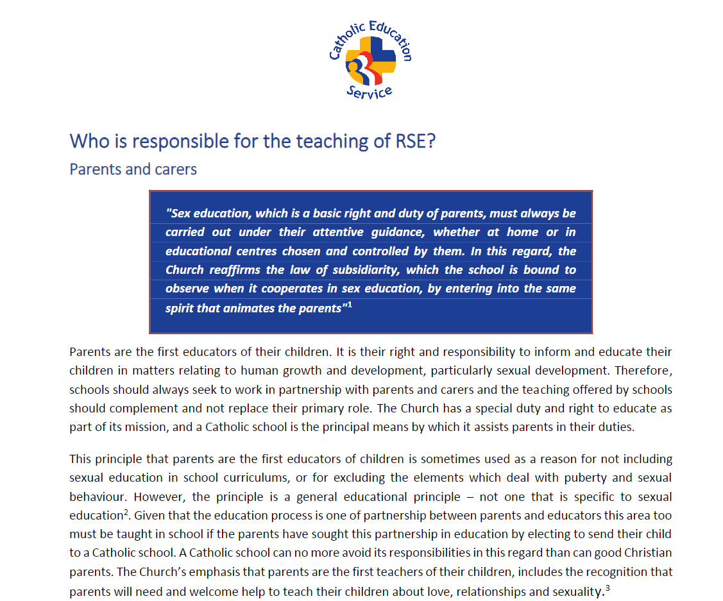
Who is responsible for the teaching of RSE?
Parents
Governors
Headteacher
Teachers and other staff
Visitors and external speakers
Parish and diocese
Notes:
‘school-based programmes are complemented with the involvement of parents and teachers, training institutes and youth-friendly services.’

Slide 29
Partnership with parents
Primary educators of children
Unique knowledge of your children
Ability to have regular conversations
Impart our shared values.
Teach alongside the school.
RSE most effective when reinforced at home and elsewhere.
Some parents find it difficult or lack confidence.
Some homes are unable to provide this.
Some children prefer these conversations outside the home
What would you like from our consultation?
Notes:
‘school-based programmes are complemented with the involvement of parents and teachers, training institutes and youth-friendly services.’

Slide 30

DfE- Parents rights
The important lessons you teach your child about healthy relationships, looking after themselves and staying safe, are respected and valued under this new curriculum.
Teaching at school will complement and reinforce the lessons you teach your child as they grow up.
Your child’s school is required to consult with you when developing and renewing their policies on Relationships Education. These policies must be published online and be available to anybody free of charge.
You can express your opinion, and this will help your child’s school decide how and when to cover the content of the statutory guidance. It may also help them decide whether to teach additional non-statutory content.
Schools are required to ensure their teaching reflects the age and religious background of their pupils.
Notes:
Th
Link between parents as first teachers and parent rights.
Reassure they will be informed about what they will be learning.

Slide 31
DfE - Right to withdraw your child- Primary
You cannot withdraw your child from Relationships Education because it is important that all children receive this content, covering topics such as friendships and how to stay safe.
Your child’s primary school can choose to teach Sex Education. If you’d like to know more about this, we recommend speaking to the school to understand what will be taught and when. If you do not want your child to take part in some or all of the lessons on Sex Education, you can ask that they are withdrawn. At primary level, the head teacher must grant this request.
The science curriculum in all maintained schools also includes content on human development, including reproduction, which there is no right to withdraw from.

Slide 32
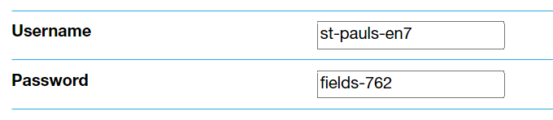
Programme details
Tenten – supported by the Diocese of Westminster
https://www.tentenresources.co.uk/parent-portal/

Slide 33
7 key decisions to make
Key Decision #1: Genitalia
Key Decision #2: Puberty
Key Decision #3: Life Cycles
Key Decision #4: Talking About Pornography
Key Decision #5: Talking About Sex
Key Decision #6: Female Genital Mutilation (FGM)
Key Decision #7: Discussing Protected Characteristics concerning sex

Slide 34
Key Decision #1: Genitalia
In Key Stage One, a decision must be made about whether to introduce names of genitalia to Years 1 and 2.
At St Paul’s Catholic School, we have decided that we will teach this for the below reasons:
The first is that this is the stage at which we talk to children about the differences between boys and girls. Here, it is important not to uphold negative gender stereotypes and, in fact, the non-physical differences between boys and girls at this age are small and difficult to define. By linking gender to biological sex, it helps children to understand the difference, equality and complementarity of boys and girls.
The second is a safeguarding issue. The argument goes that if young children are better able to confidently articulate about private body parts, they are better equipped to identify experiences of feeling uncomfortable if any form of abuse takes place.

Slide 35
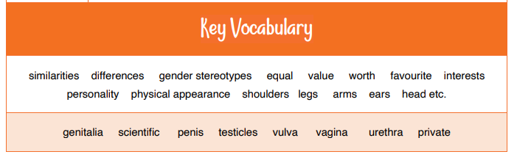
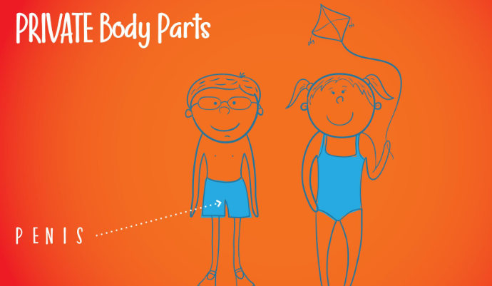
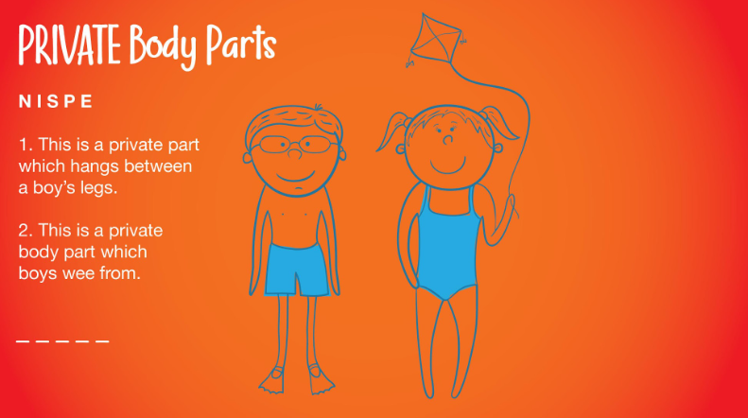
Example of what is shown

Slide 36
Key Decision #2: Puberty
In Module 2 of Lower Key Stage One, we will provide two sessions on puberty and changing bodies. We have decided to teach this in year 4 and not in year 3 in line with NHS guidance on starting puberty to ensure all children al fully prepared.
The reason for this is that “The average age for girls to begin puberty is 11, while for boys the average age is 12. But it's different for everyone. It's completely normal for puberty to begin at any point from the ages of 8 to 14. The process can take up to 4 years.” NHS England

Slide 37
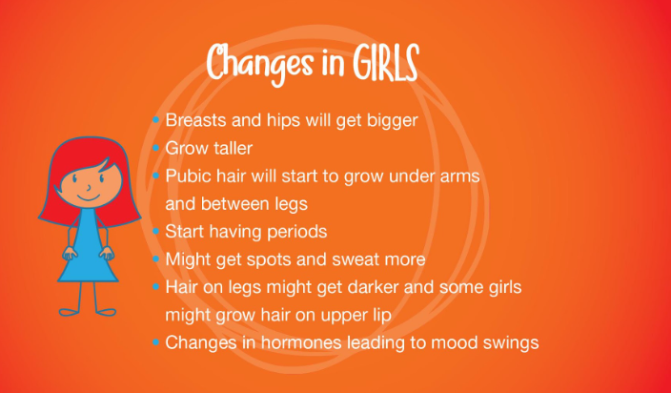
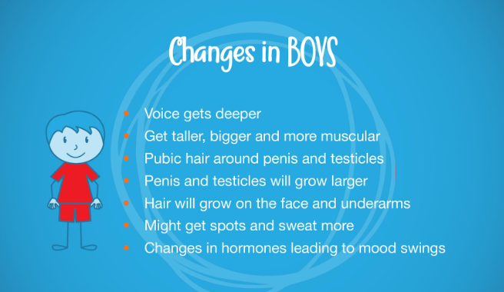
Example of discussion

Slide 38
Discussion groups
Male
Where does pubic hair grow, and do you have to put deodorant on it like under your arms?
Sometimes girls shave their underarm or pubic hair, but they don’t have to. Do boys have to get rid of theirs?
If a boy was feeling embarrassed about his voice cracking and breaking, what would you say to him?
If one person grows and develops more quickly than someone else, does that matter? Why?
If someone was worried about what they will end up looking like as an adult, what would you say to them?
What should a boy do if he gets spots?
How often should a boy put deodorant on? How often should a boy wash?
Is it normal for a boy’s penis and testicles to get larger during puberty? Is it normal for one testicle be bigger than other?
If someone felt embarrassed about sweating more, what would you say to them?
Is there anything wrong with a teenager whose beard hasn’t started to grow?
Hormone changes during puberty mean young people can experience mood swings. How might someone be able to cope with mood swings?
If you or a friend was worried about anything, including about puberty, what could they do?
Female
Where does pubic hair grow, and do you have to put deodorant on it like under your arms?
If a girl is worried about starting her period unexpectedly, what is the best way she can prepare herself?
During puberty, girls should never go swimming just in case their period starts. Is that true?
What things would someone need to have to hand during their period? And if they forgot, what could they do?
Does a girl HAVE to shave or get rid of her pubic hair?
If one person grows and develops more quickly than someone else, does that matter? Why?
If someone was worried about what they will end up looking like as an adult, what would you say to them?
What should a girl do if she gets spots?
How often should a girl put deodorant on? How often should a girl wash?
Is there anything wrong with a girl whose period hasn’t started yet?
If someone felt embarrassed about sweating more, what would you say to them?
Can girls grow hair on their upper lip?
Hormone changes during puberty mean young people can experience mood swings. How might someone be able to cope with mood swings?
Is it normal for a girl’s breasts and hips to get larger during puberty? Is it normal for one breast be larger than the other?
If you or a friend was worried about anything, including about puberty, what could they do?

Slide 39
Key Decision #3: Life Cycle
In Lower Key Stage Two, Module One, Unit 4, there is a session called Life Cycles in which children learn about the human reproductive system. However, it does not discuss sexual intercourse. This teaching is given in the context of being created, chosen and loved by God; the session concludes with a meditation, giving children the opportunity to reflect on how they have been wonderfully made and to understand that they are formed of body and soul. Teaching about the reproductive system is not explicitly requested as part of the statutory RHSE curriculum. The DFE guidance says that primary schools “should ensure that both boys and girls are prepared for the changes that adolescence brings and – drawing on knowledge of the human life cycle set out in the national curriculum for science - how a baby is conceived and born. In Life to the Full, this session is provided as a stepping-stone to Key Decision #5: Talking About Sex (see below). The school governing body, in consultation with parents, should therefore discern whether these lessons provide appropriate steps of preparation towards adolescence for prepubescent children. Ten Ten Resources have provided the resources so schools can teach these lessons within the context of our core identity as God’s children

Slide 40
Key Decision #4: Talking About Pornography
The next key decision concerns talking about pornography. One of the sessions in Upper Key Stage Two, Seeing Stuff Online, addresses the risks that children face from seeing explicit images and videos online. On the one hand, this is very much a lesson about ‘online safety’ and therefore falls under the statutory ‘Keeping Children Safe in Education’ (England)
This session explores the emotional and mental impact that videos and images of an adult nature can have on children and young people, particularly pornography*. In Episode 8 of ‘Paradise Street’ we explore the relationship that the characters have with online devices. Leyla and Siobhan rave about a vlogger they have discovered, whilst Finn secretly discovers a pornographic website. Initially shocked and scared by what he has seen, he becomes more and more drawn to it. When his Dad discovers what Finn has been looking at, he sits down with him for a chat to explain the effect that these videos and images will have on his young brain.

Slide 41
Key Decision #5: Talking About Sex
The next area for consideration is about whether to include the Making Babies Part 2 session in Upper Key Stage Two which answers the question: ‘Where do babies come from?’ Naturally, this question leads to a discussion about sexual intercourse, and we would like to leave it to the individual school, in consultation with parents, about the inclusion of this Go to Contents Life to the Full and Life to the Full Plus Programme Coordinator Manual Last updated: 29 August 2023 18 session.
Teaching about sexual intercourse to primary school children is not part of the statutory curriculum; however, several dioceses that we have partnered with have asked that resources are provided which deal with this topic as it is a natural progression of the conversation around the scientific understanding of how babies are made (sperm and egg)

Slide 42
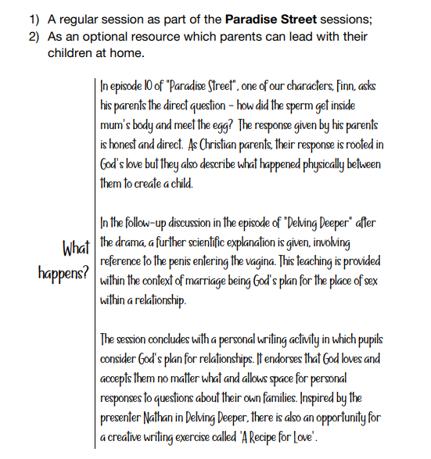

Slide 43
Key Decision #6: Female Genital Mutilation (FGM)
This area for consideration is about whether to include teaching about Female Genital Mutilation (FGM). Although the duty to teach about FGM is not statutory for primary schools, it can optionally be applied following consultation with parents and governors. The National FGM Centre advises that girls are at most risk at primary school age, and therefore recommends that primary schools also teach FGM where possible. The Life to the Full programme offers schools the opportunity to include teaching on FGM at KS1, LKS2 and UKS2, as part of Unit 4: Keeping Safe which is part of Module 2: Created to Love Others. At each Key Stage where there is optional FGM teaching content, teachers are also signposted to this guidance and also resource provision higher up in the curriculum, so that teaching can be tailored carefully for the age, stage and risk level of the children in your care. The content for this is age-appropriate and in line with the CES model policy. At St Paul’s we feel it is important that our children have this education at an age-appropriate level and consult to include it within our teaching. The content for this teaching can be found on the parent portal.

Slide 44
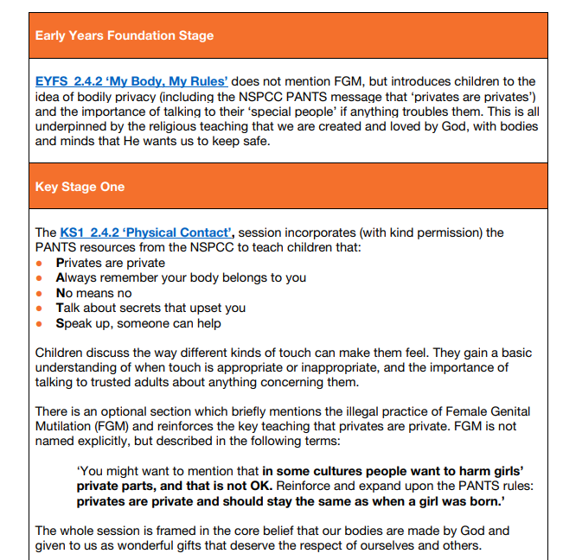

Slide 45

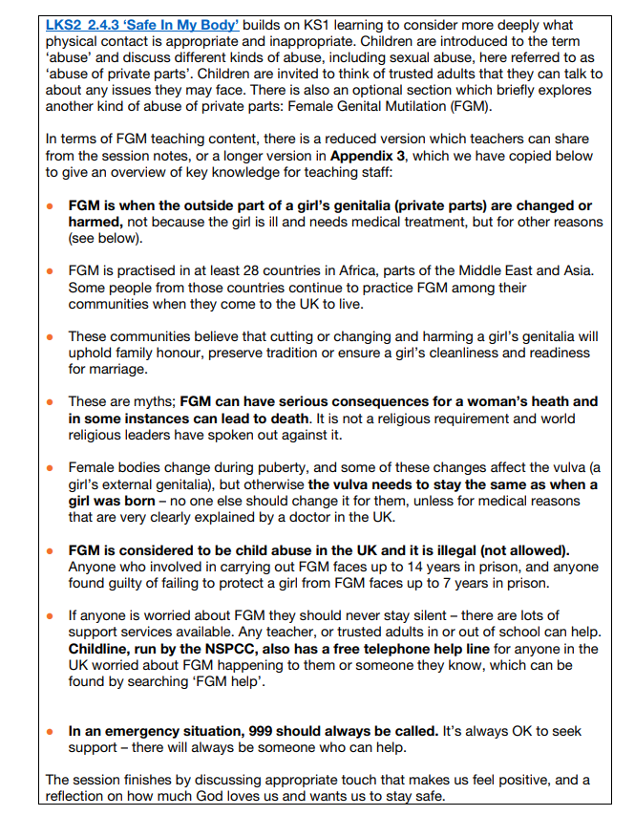

Slide 46
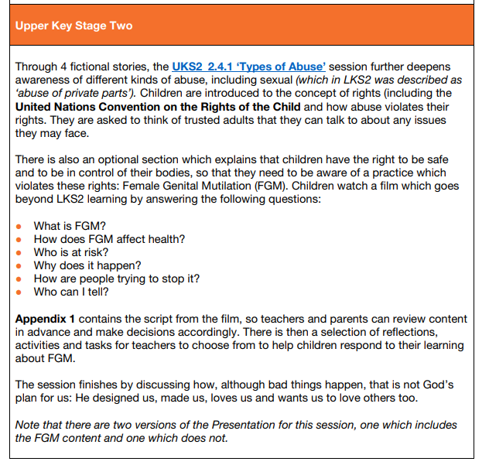

Slide 47
Key Decision #7: Discussing Protected Characteristics concerning sex
The final area concerning a Key Decision is linked to the UKS2 session in Module 2 Unit 2 titled, “Build Others Up”. This resource is intended for use in Year 6. At the beginning of the session, children are invited to watch the film ‘Imagine a world…’ which introduces children to the terms fairness, bullying, prejudice, and discrimination, and the protected characteristics of age, disability, marriage and civil partnership, pregnancy and maternity, race, and religion or belief. The protected characteristics of sex, sexual orientation and gender reassignment are not explicitly named within the film

Slide 48

Parent Consultation
We are consulting on our RSE policy.
The school welcomes and will take account of and listen to your views. Decisions will also be based on the needs of pupils, the views of staff and governors as well as compliance with legal requirements as set out in the DfE guidance and the Equalities Act 2010.
Ultimate decisions about the curriculum and policy will be up to the school.
To take part in the consultation please complete the google form by 13th July 2024
Notes:
TOS
Use existing strategies if they are effective - multiple strategies
Group / one to one/ form/ online etc…..
Same questions – multiple formats

Slide 49
Timeline - What Next?
Parent Information Session 1 – Today
Statutory requirements
Distinctive Catholic approach
Parent consultation on policy from 13th June to 13th July
Please contribute to this consultation via google form link
Parents will be informed of the conclusions that have been reached and the curriculum and policy that has been adopted via the school newsletter and publishing the policy on the school website.
Parent information session 2 date- September class curriculum meetings
Curriculum and resources
Notes:
TOS

Slide 50

Parents/ Carers responses
Notes:
TOS
Build in time for questions – be confident
Personal q’s individually
Decide how you will take questions? Who is going to answer them?
All will be answered but it doesn’t have to be today. – say don’t know .
Consider what you might be asked in advance – maybe have a run through
personal or inflammatory individually

Slide 51
Closing Prayer
Heavenly Father,
As we come to the end of our time together we thank you for what has been accomplished here.
May the matters discussed serve as a catalyst to move us forward and cause us to advance and see growth in all areas of our lives.
May we leave here recognising that you are the God of all wisdom and you are willing to lead us forward.
This we pray in the name of Jesus the Lord,
Amen
Notes:
TOS

