Slide 1



SEND INFORMATION REPORT
SEPTEMBER 2026-2027
St Paul’s Catholic Primary School
SEN Information Report based on the model developed by representatives from Hertfordshire parents and schools

Slide 2



BACKGROUND
Our SEN information report should be read in conjunction with the Policy for SEN available on the school website and the DFE: SEN Code of Practice 2015 (link on school website)
We are committed to supporting families to thrive and early intervention and support is vital. Early intervention and support is available through our Families First Key Worker (Lisa Crook) Should you wish to find out more about Early Help and Support for your family, please see:
Families First Portal Link:
https://directory.hertfordshire.gov.uk/kb5/hertfordshire/directory/familiesfirst.page?famili
esfirstchannel=1
At St Paul’s our Special Educational Need Co-ordinator (SENCO) is Mrs. Lisa Crook.
A SENCos role is to lead the school’s strategic objectives for SEND and inclusion, support teachers and wider staff in the continued professional development and co ordinate and monitor the effective provision of children at SEN support and EHCP level.

Slide 3


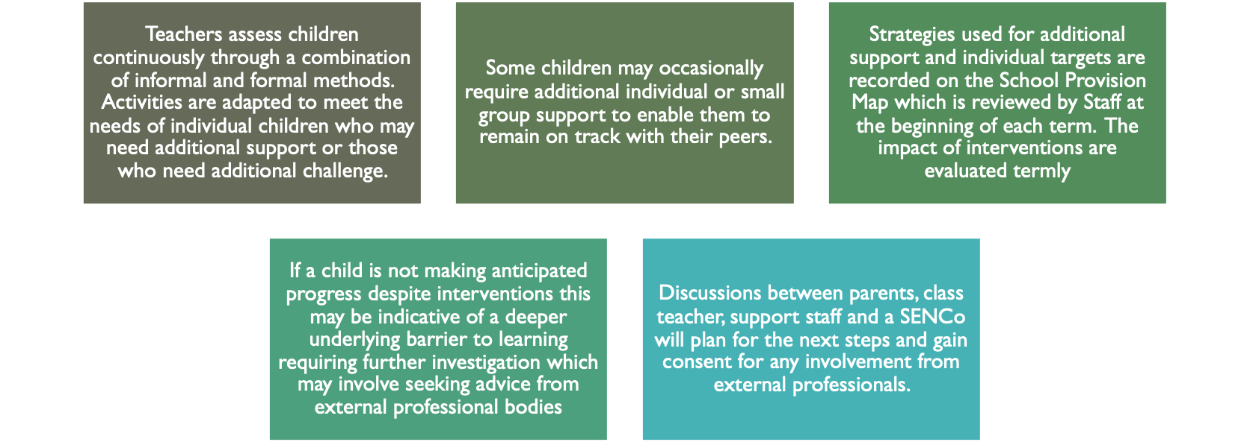
HOW DOES THE SCHOOL KNOW IF CHILDREN/YOUNG PEOPLE NEED EXTRA HELP?
Every school has a ‘Graduated Response’ and ‘APDR’ cycle. This is the schools ways of responding to potential SEND needs and following a process of Assess, Plan, Do, Review’ (APDR). Please see our school website for a helpful flow chart which will direct you to both the process and the staff members involved.

Slide 4



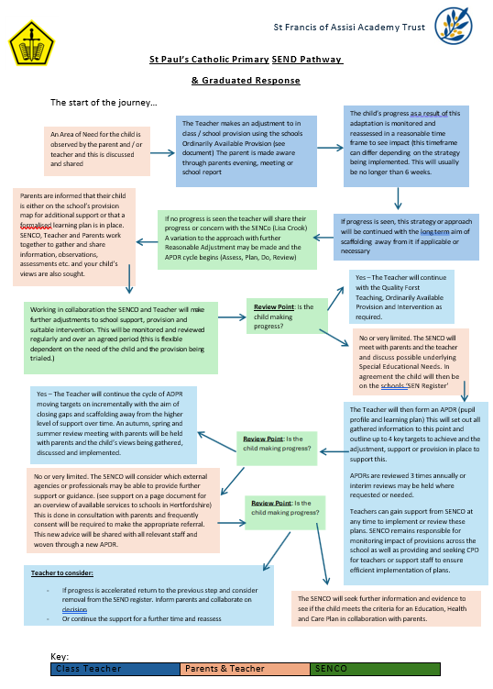
WHAT SHOULD I DO IF I THINK MY CHILD MAY HAVE SPECIAL EDUCATIONAL NEEDS?
Please see our school’s Graduated Response on the SEND page of our website
Should you have any questions at all, please do contact your school’s class teacher in the first instance or Mrs Crook via
lcrook@stpauls373.herts.sch.uk

Slide 5




SEND AND ORDINARILY AVAILABLE PROVISION
SENCos across St Francis of Assisi Trust agree that pupils to be included on the DFE census for SEN Support
and therefore in the school’s SEN register are defined by:
Pupils who have a learning difference or disability and require provision which is additional to or different from the universally available provision as a result of their learning difference or disability.
Hertfordshire County Council have recently released the following document which outlines what schools are advised should be their Ordinarily Available Offer and Practice for all children in schools. Note this is not statutory but good practice for all pupils.
St Paul’s have taken this document as a basis and developed their own Ordinarily Available Provision offer. Please see our school website under SEND for this. This outlines what all teachers are able to provide in their classrooms or through planned intervention before any child is identified as having SEND. It is the first step of our Graduated Response to reacting to any potential learning need.
5

Slide 6

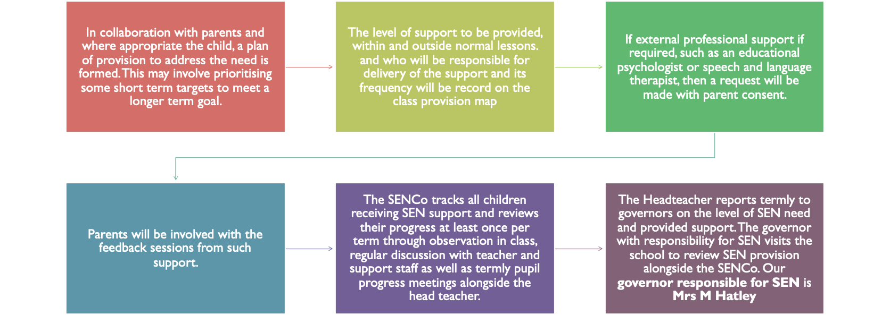
HOW WILL SCHOOL STAFF SUPPORT MY CHILD?
The head teacher and SENCO report termly to governors on the level of SEN need and support. The governor with responsibility for SEND visits school termly. Our governor with SEND responsibility is Mrs Rita Odumosu.

Slide 7






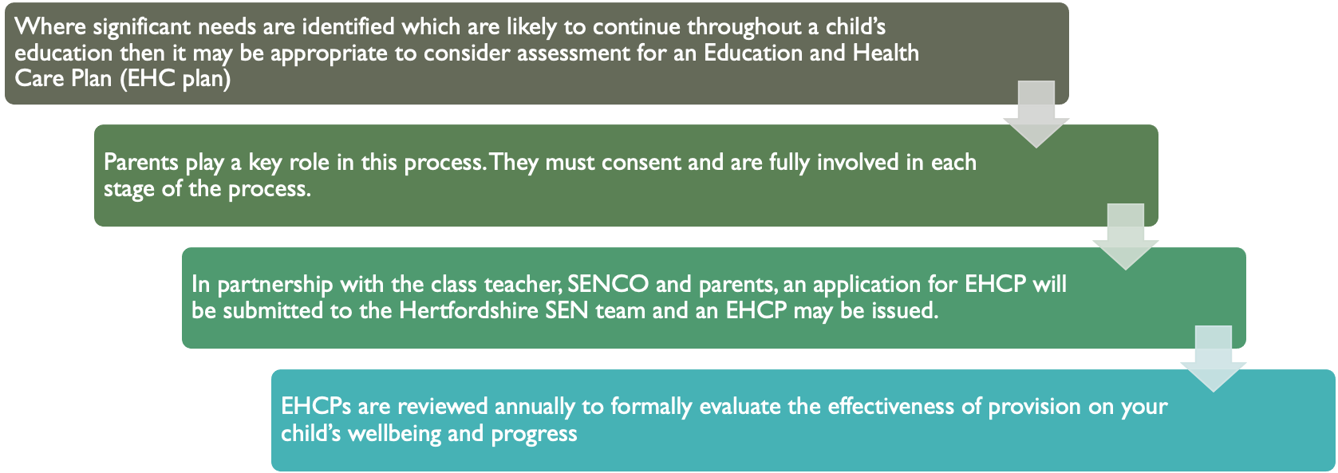
EDUCATION HEALTH AND CARE PLAN (EHCP)
To note: if your child is in EYFS, their EHCP will be reviewed every 6 months.
Our school website has a link to a parents guide to the process of EHCNA (EHCP Assessment process and timescales)

Slide 8




HOW WILL I KNOW HOW MY CHILD IS DOING?
Termly parent’s consultation evenings where teachers discuss the progress of
children give valuable feedback regarding the success of intervention
Annual written reports are also provided for all children, which will make reference to any SEN support provided
For children receiving SEN Support - additional meetings are held with the teacher (and if required the SENCo) to discuss progress against the child’s individual targets and the agreeing of new targets. These meetings are once per term or more regularly if agreed in collaboration with teacher, parent and SENCo
Additional meeting to feedback on recommendations from any external professional advice will also be held.
Short discussions may take place before school or at the end of the day regarding specific issues or events and /or through the use of the home/school diary, online portals such as Tapestry or Seesaw. Communication is personal and and so the method of which will be agreed with parents to ensure it is beneficial and manageable for all parties.
Regular contact with parents is vital and parents may always make an
appointment to see their child’s teacher or the SENCo at any time

Slide 9
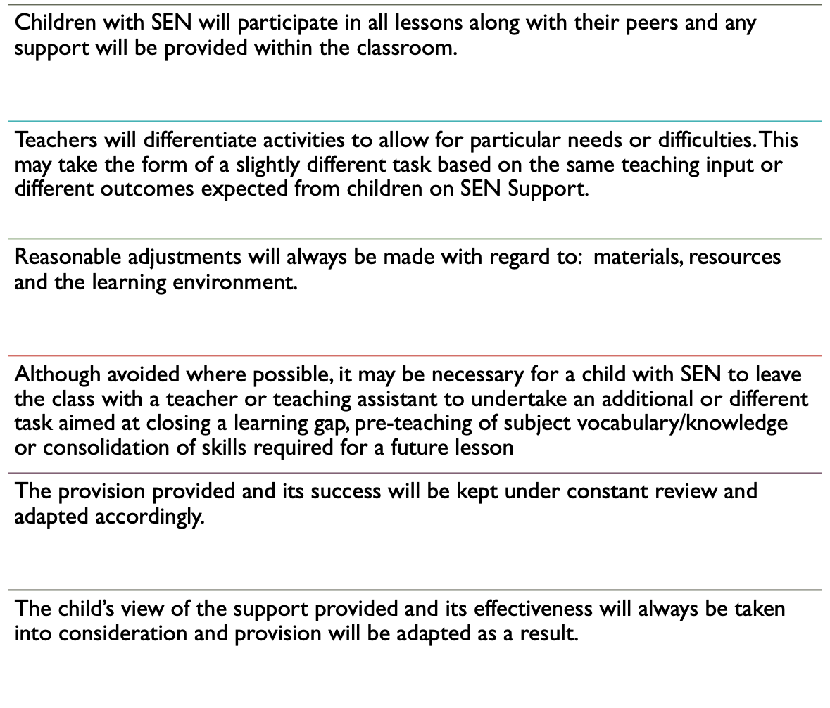






HOW WILL THE LEARNING AND DEVELOPMENT PROVISION BE MATCHED TO MY CHILD’S NEEDS?

Slide 10





WHAT SUPPORT WILL THERE BE FOR MY CHILD’S OVERALL WELLBEING?
Some children may have social and emotional difficulties which may form barriers to learning and affect their confidence or overall emotional development.
Children’s emotional literacy is developed across the whole school with a consistent approach to the teaching of emotional literacy and regulation. Every classroom has visual prompts for daily ‘check ins and emotional literacy related vocabulary.
Individual and group support sessions are used as opportunities to explore these areas and discuss the child’s concerns. These may take the form of 1:1 support in Emotional Literacy sessions or through a Lego Therapy Programme with trained staff, Drawing and Talking sessions or Rainbows Pastroal Support.
Social stories may be used or ‘Circle of Friends’ activities when appropriate.
Our ‘Rainbows’ pastoral support programme is a powerful tool for talking and sharing helping to
approach difficult subjects in an age appropriate way – see website for more information.
It may be appropriate to involve the use of external agencies such as CAMHS (Children and Adolescent Mental Health Services) to assist the school in developing appropriate programmes.
Other options could include the use of a Families First Assessment to support the whole family in
managing a child’s needs.
- Referrals to external support agencies such as the nursing service to provide a short term bank of
sessions aimed at wellbeing which can be run in school or art/play therapy may also be available
Children with medical or physical needs will be supported appropriately to ensure any barriers to learning are minimised (See Medical Needs Policy). Our school is committed to increasing our capacity to meet the needs of children with medical and physical needs and have an Accessibility Stragety Plan in place to do so. Please see the school website for this detail.

Slide 11
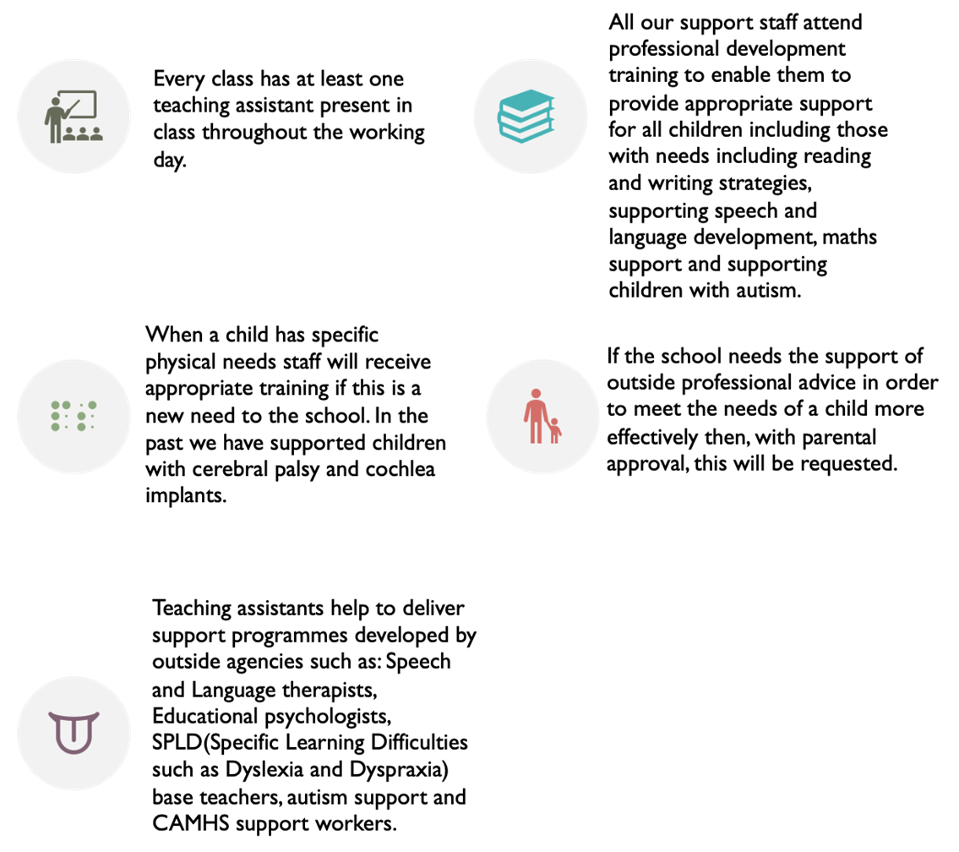








WHAT SPECIALIST SERVICES AND EXPERTISE ARE AVAILABLE AT OR ACCESSED BY THE SCHOOL?
Examples of external services and specialists we
access to support children at St Paul’s include:
Rivers ESC (behaviour, SEND and anxiety)
Amwell View Outreach (ASD and specialist level of SEND need)
SALT (speech and language therapy)
OT (Occupational therapy team)
Sensory Processing Service
Dspl4 SEND Family Support Worker (Home family
support and advice)
Cognition and Learning Team
Autism and Social Interaction
Ask SALI advice Line
Deaf and Hearing Impairment Team
BCW Partnership

Slide 12





WHAT TRAINING HAVE THE STAFF, SUPPORTING CHILDREN AND YOUNG PEOPLE WITH SEND, HAD OR ARE HAVING?
All support staff are trained in ‘Twinkl’ supporting phonics reading skills for all phases and can support children’s reading from any point. This includes a ‘Keep Up’ programme for children who are at risk of falling behind with the acquisition of phonics and reading as well as a SEND programme.
Likewise all support staff receive training to enable them to effectively support writing development and mathematics.
All teaching and support staff, have received training for supporting children with autism and ADHD.
All staff in school work with external professional services to gain expertise and training such as Rivers ESC Behaviour Support Team, Emotional Wellbeing and Behaviour Special's (EYFS) Speech and Language Therapy, SLCN and Autism Team.
Several have supported children with physical needs involving wheelchairs. Needs that arise that are new to the school trigger new training needs which are addressed at the earliest opportunity.

Slide 13




















HOW WILL YOU HELP ME TO SUPPORT MY CHILD’S
LEARNING?
If your child is identified, in collaboration with yourself, as requiring SEN support then you will be invited to at least one focused review meeting per term to discuss progress against targets and setting of new targets. You are welcome at any time to discuss current needs and support strategies that can be implemented in school and at home.
In addition to these will be the usual termly parent consultations and the annual school report to parents.
There may also be more frequent communication as required through the agreed communication method e.g Tapestry / SeeSaw, during handover at the gate or through additional meetings related to observation/consultation visits by external professionals. This will guide you with what support you may be able to put in place to work collaboratively with the school towards pre agreed and identified next step targets. These form the ADPR cycle.
Periodically we offer parent workshops focussed on supporting topics such as reading, maths
homework, internet and e-safety and research projects.
Regular SEN parent coffee mornings are also hosted at St Pauls to ensure parents develop a network of support in the parent community sharing ideas, strategies and just having a chat! Often external professionals attend these sessions also to upskill parents and draw attention to support and services which are available.

Slide 14
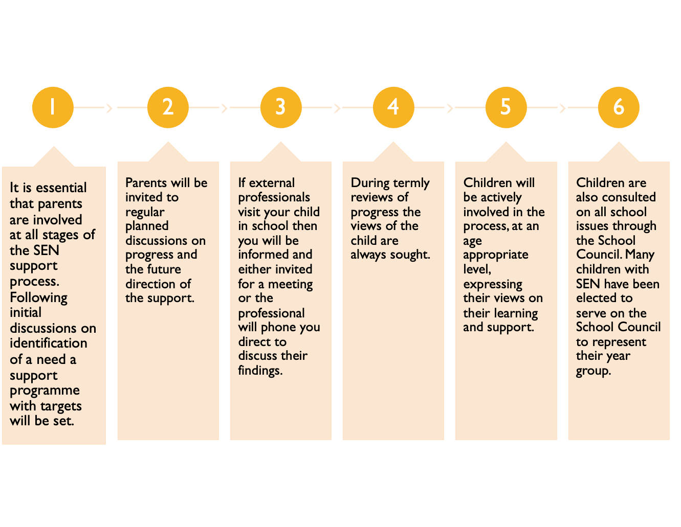








WILL I BE INVOLVED IN DISCUSSIONS ABOUT AND PLANNING FOR MY CHILD’S EDUCATION?

Slide 15
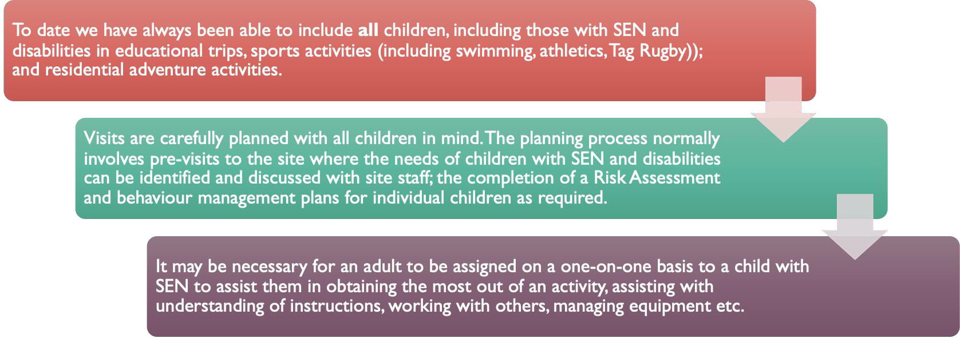
HOW WILL MY CHILD BE INCLUDED IN ACTIVITIES OUTSIDE THE CLASSROOM INCLUDING SCHOOL TRIPS?

Slide 16



HOW ACCESSIBLE IS THE SCHOOL ENVIRONMENT?
St Paul’s has developed an annual action plan to ensure it continues to move towards a fully accessible school. The review of this annual action plan is available on the school website alongside an Accessibilty Action Plan which sets out the schools aims for the next 3 years to improve access to The Curriculum, Physical Environment and Access to Information for both parents and carers and pupils at St Pauls.
The school is predominantly on one level, making most areas easily accessible for pupils and visitors with mobility needs. There are ramps around the site to support wheelchair users and ensure access to the main areas of the school.
There are three steps between the KS1 and KS2 areas of the building. A lift is available to provide wheelchair users and others with limited mobility safe and convenient access between these areas.
There is a specific toilet in the Early Years area for wheelchair users and changing when required. Additionally, by the main office, there is a large toilet cubicle that is suitable for disabled use. In addition, we also have access to a modern, fully equipped accessible adult toilet.

Slide 17

DISABILITIES AND EQUALITY
Admissions and Induction
Where it is appropriate children with disabilities may require additional induction on admission to our school.Additional opportunities for planning meetings to ensure resources and the environment are prepared to meet the needs of the child may occur prior to induction. Further opportunities for the child to visit the school, experience the environment and meet staff may be timetabled to ensure children and parents feel confident prior to starting at St Paul’s. For further details regarding admissions please see Admissions Policy.
Equality vs Equity
We are committed to meeting the needs of all children.The school fully meets the requirements of the amended Disability Discrimination Act that came into effect in 2005.All reasonable steps are taken to ensure that these children are not placed at a substantial disadvantage compared with non-disabled children.
Children are provided with ‘what they need to succeed’ in order to make the same rate of progress as their peers in conjunction with their developmental stage. All children need different resources to support their learning and their ability to access the environment and curriculum. Some children may require additional resources to help them to achieve.These may include, but are not restricted to; adult support, ergonomic seating or equipment, additional sensory stimulus breaks, a differentiated curriculum, visual aids to communicate or plan activities, hearing loops or visual supports, differentiated time table or environment / area to access learning in.
Through regular PSHE sessions we teach the differences and similarities between different groups of people and individuals and support all of our children to have a secure understanding of others differences and needs in order to succeed. Children are taught tolerance and respect towards all peers despite their disabilities or differences.
Curriculum & Delivery of information
Teachers modify teaching and learning as appropriate for children with disabilities. For example, they may give additional time to complete certain activities, or modified teaching materials, equipment or lesson content, or offer alternative activities where children are unable to manipulate tools or equipment.
Teacher’s and support staff work with the child and the parents to decide where challenges are apparent and what resource or strategy could be used to overcome these barriers.These are then regularly reviewed at parent meetings to ensure a strong partnership between home and school to meet the best interest of the child.

Slide 18















HOW WILL THE SCHOOL PREPARE AND SUPPORT MY CHILD TO JOIN THE SCHOOL, TRANSFER TO A NEW SCHOOL OR THE NEXT STAGE OF EDUCATION AND LIFE?
For children with existing identified SEN joining the school, the SENCo will contact the SENCo at the
child’s previous school to ensure all information and support plans are effectively transferred.
With children in Early Years, staff may pay home visits and visit the child in their setting in order to assess the level of need and support which may be required at St Pauls. The school uses Hertfordshires Early Years Transition Toolkit to help plan, guide and make a success of all transitions into Nursery and Reception.
In the summer term we have transition sessions so children become used to the environment they will be moving to. The need for additional support is considered and transfer discussions take place between the teachers and support staff concerned. Full transition plans are made for pupils with SEND through SENCo and teacher discussions. These can be highly personal due to the needs of individuals but may include activities such as: additional classroom visits, transition books and resources to take home with visuals and photographs, visits with new teachers or trusted adults, a staggered timetable, the moving of designated furniture or resources / safe spaces for individual children, visits to new settings with trusted adults etc If you feel your child would benefit from enhanced transition opportunities, please do contact the SENCo to discuss next steps.
When children with SEN transfer to secondary school the teacher and SENCo will meet with the SENCO from the secondary school to transfer all necessary information. Usually, the SENCo at the new school will meet with parents and invite the child to visit the school prior to the main induction day.

Slide 19





















































HOW ARE THE SCHOOL’S RESOURCES ALLOCATED AND MATCHED TO
CHILDREN’S SPECIAL EDUCATIONAL NEEDS?
The school receives a small budget for SEN provision.
This funding is for the schools discretion to spend. It can be used for the training of staff to meet needs, the purchase of resource or equipment to support individuals or groups, the funding of intervention or provision for children or employment of support staff to assist children with SEN and to provide additional resources that may be required to aid their learning beyond the resources commonly used by most other children. This funding of additional staff is however increasingly being advised against by external professionals. Funding for1:1 support can only be accessed for children with Specialist levels of funding through the route of an EHCP. Even with this level of funding a child is not guaranteed to receive 1:1 designated support. The funding provided is to help the school to provide the provision set out in Section F of a child’s EHCP and therefore it remains at the discretion of the school how such funding should be best spent.
For some children this funding and 1:1 support is a beneficial resource in order to deliver highly personalised curriculum and provision outside of what is available as part of high quality teaching and reasonable adjustment. The SENCO in conjunction with Head teacher will plan for how EHCP funding will be spent to best meet the needs of the child based on advice and current research.
The funding provided does not cover the full cost of our SEN support staff and resources. Governors try to ensure that sufficient funds are budgeted to meet the needs of SEN Support based on the needs across the school community.
To meet some children’s needs, who do not currently have an EHCP, additional funding may be required to provide a short term intervention or resource. This is allocated through the process of FIF funding (as of April 2026). Please speak to the SENCo if you think that your child would benefit from short term targeted support to find out more.

Slide 20

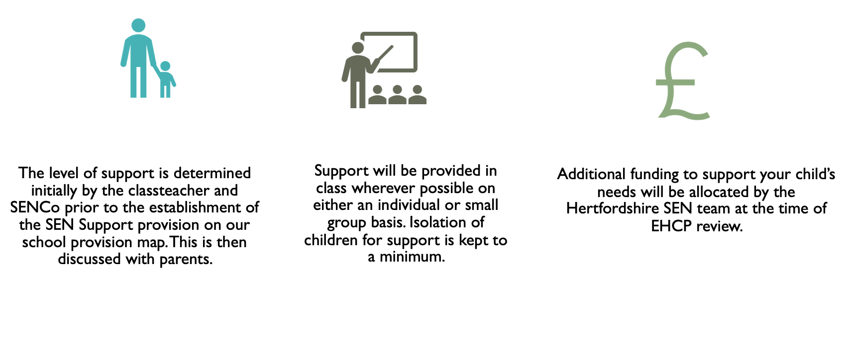
HOW IS THE DECISION MADE ABOUT HOW MUCH SUPPORT MY CHILD WILL RECEIVE?

Slide 21



HOW CAN I FIND INFORMATION ABOUT THE LOCAL
AUTHORITY’S LOCAL OFFER OF
SERVICES AND PROVISION FOR CHILDREN AND YOUNG PEOPLE WITH SPECIAL EDUCATIONAL NEEDS AND DISABILITY?
Further information on the Local Offer of services and provision for children and young people with special educational needs and disabilities within Hertfordshire parents can be found at:
https://www.hertfordshire.gov.uk/microsites/local-offer/the-hertfordshire-local-offer.aspx
For further advice and support please contact SENDIAS https://www.hertssendiass.org.uk/home.aspx

Slide 22



WHO CAN I CONTACT FOR FURTHER INFORMATION?
The first point of contact is always the class teacher. For children with SEN then it may be appropriate for joint meetings with the teacher and the SENCO
The SENCO at St Pauls (Mrs Crook) has undertaken full accreditation training in this role. She is responsible for initiating the involvement of any external professionals and for overseeing the administration and monitoring of all children receiving SEN support.
If parents are unhappy with the support being provided for their child then
they may wish to discuss this with the Executive Headteacher.
If a concern remains then parents may follow the complaints procedure to be
found on the school website.

