Slide 1
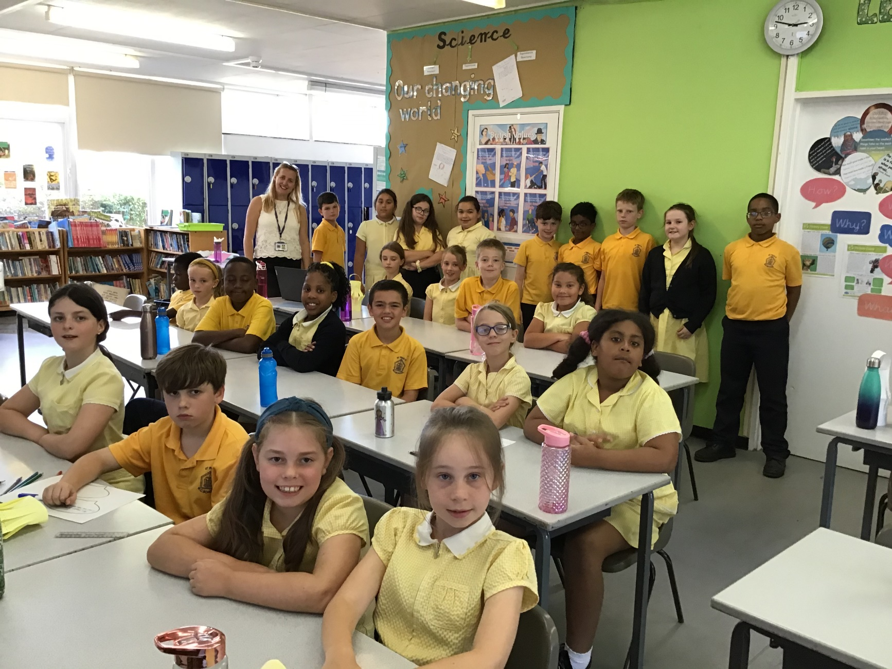
Welcome to the Year 5 Assembly!

Slide 2
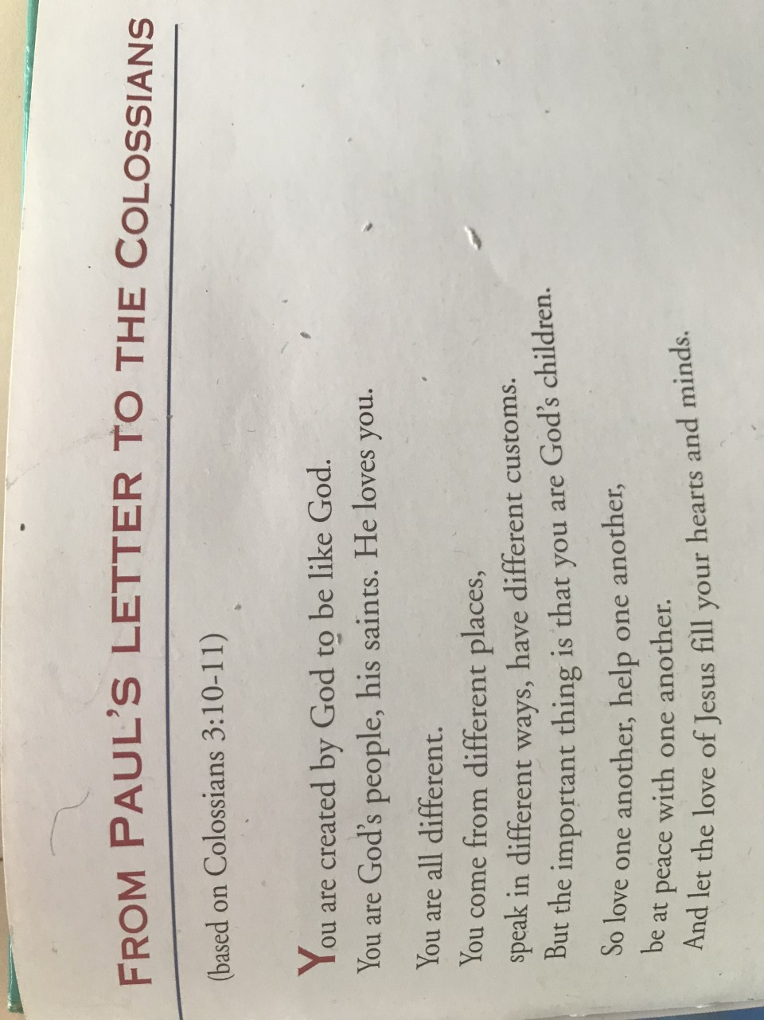
Opening Reading

Slide 3
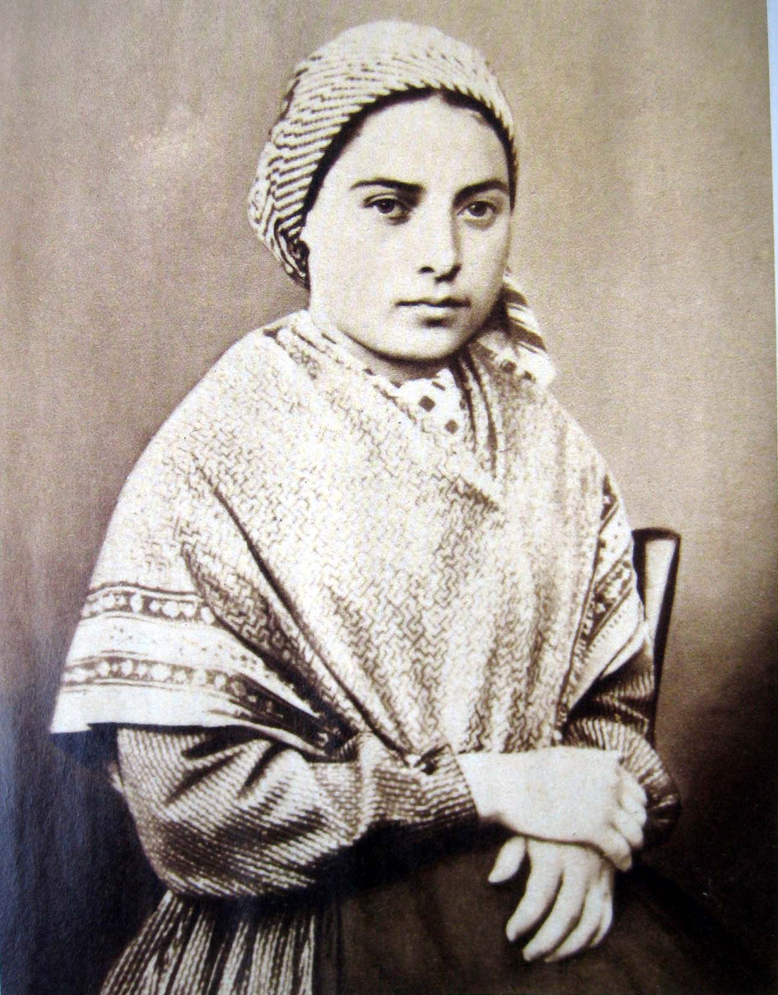
St Bernadette!
Year 5 Class Saint!

Slide 4
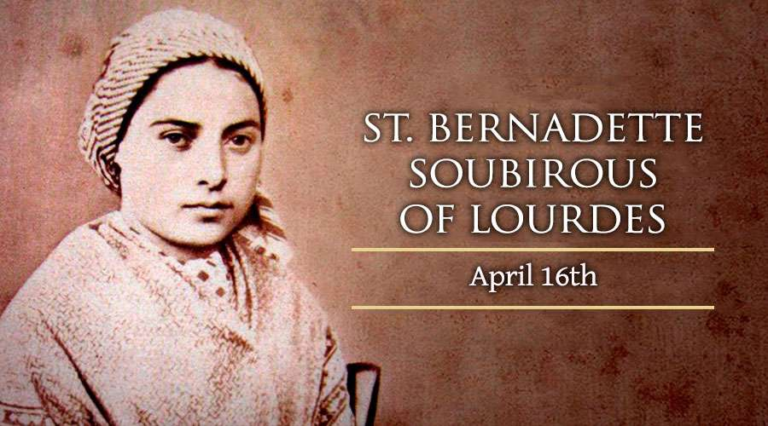
When was she born?
St Bernadette was born on the January 7th 1844
and she died on April 16th 1879 from asthma which couldn’t be treated in the olden days.
Her real name was Marie-Bernarde Soubirous and her feast day is the same as her death date
April the 16th.

Slide 5
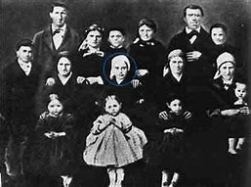
Her childhood and family life!
Hard times had fallen on France and the family lived in extreme poverty. Soubirous was a sickly child who suffered from severe asthma all through her life.
Soubirous attened school but learned very little French due to her absence from school.
The family lived in a one bedroom basement and became very poor as she grew up.

Slide 6
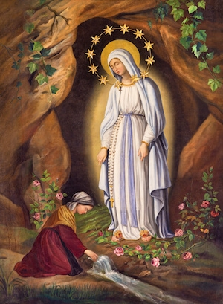
St Bernadette’s History!
St Bernadette of Lourdes was the firstborn child of the Miller family. She was very lucky to have visions from the Virgin Mary . Mary said that she will be happy not in this life but the next (in heaven).
But that wasn’t all, she actually got 18 visions from Mary.
Mary told her to build a church exactly where she saw Mary for the first time, which was in a cave.

Slide 7
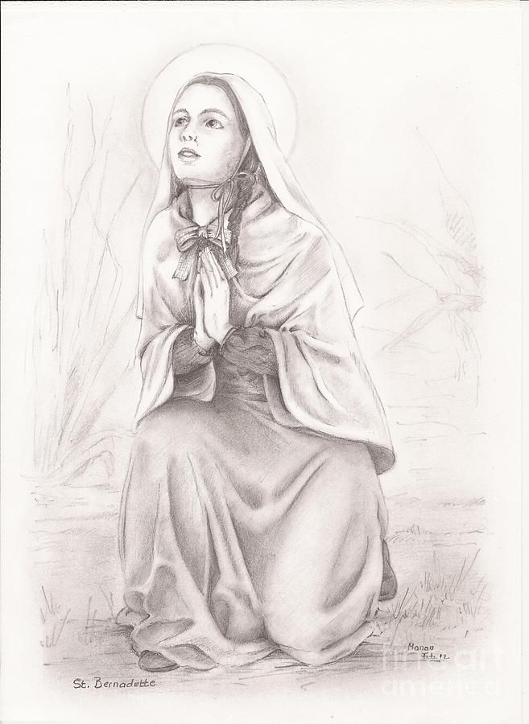
What she experienced!
Saint Bernadette of Lourdes became a Saint in Lourdes which is located in France. She is well know for receiving 18 visions from the Virgin Mary starting in 1858.
When she reported these visions, civil authorities attempted to force her to forget her accounts.

Slide 8
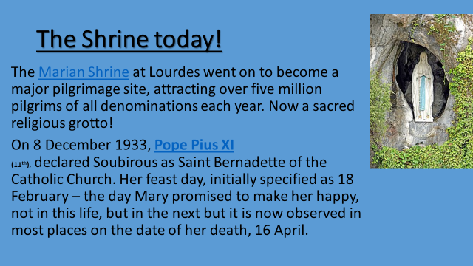

Slide 9
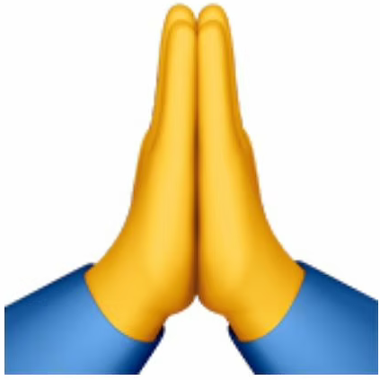
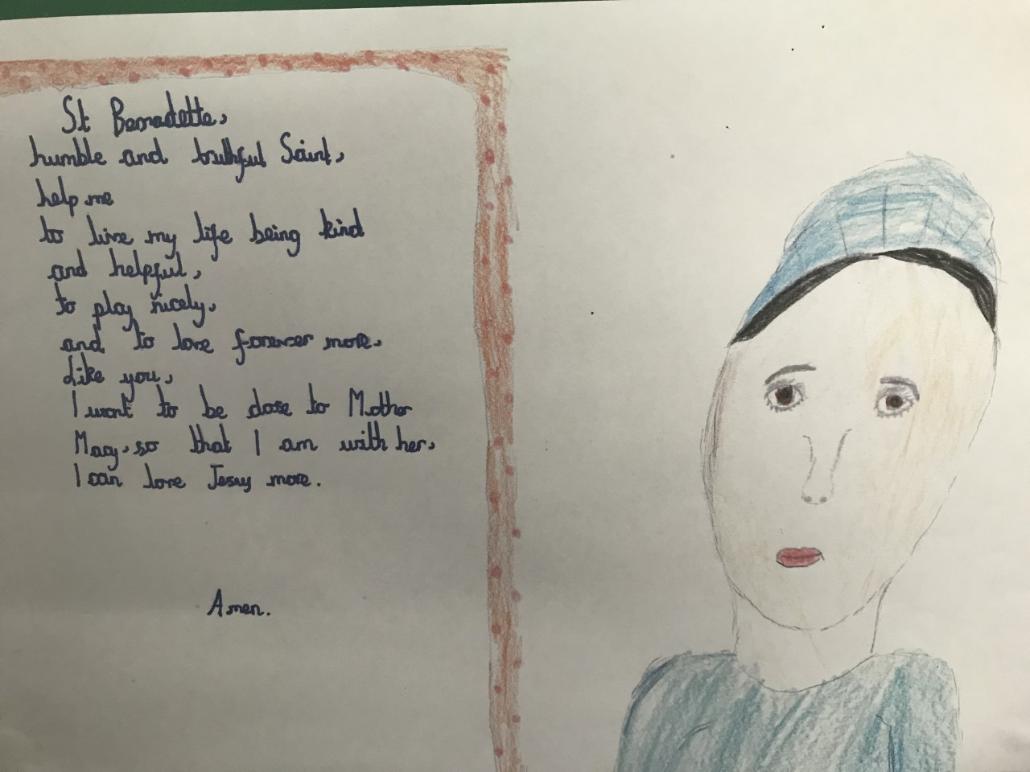
A Prayer for St Bernadette!

Slide 10
St Bernadette!
Thank you for listening!

