Slide 1

Welcome to our Year 6 Assembly
Our House Captains would like to share some information about the house saints.

Slide 2
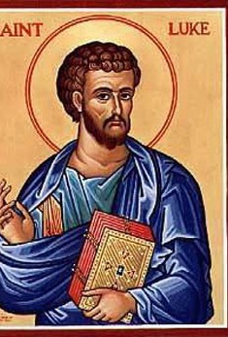
St Luke Assembly.
Green house
By Zack Lehane

Slide 3
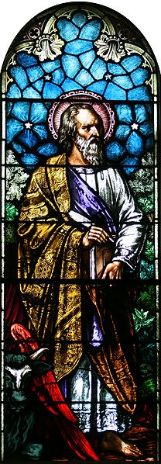
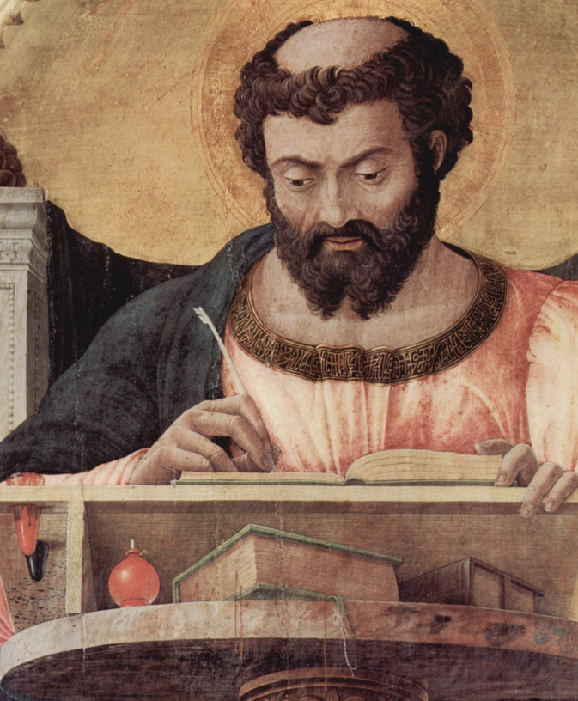
Facts about St Luke.
St Luke was born in Syria and trained as a physician.
He was also known for being a good painter, creating many works of Jesus and Mary.
St Lukes Feast day is October 18th
He is the patron saint of artists and physicians
T

Slide 4
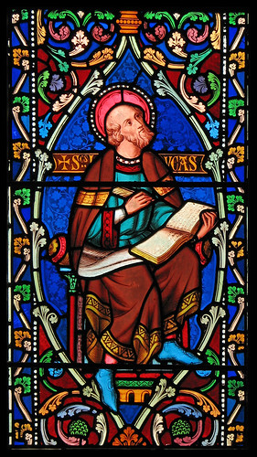
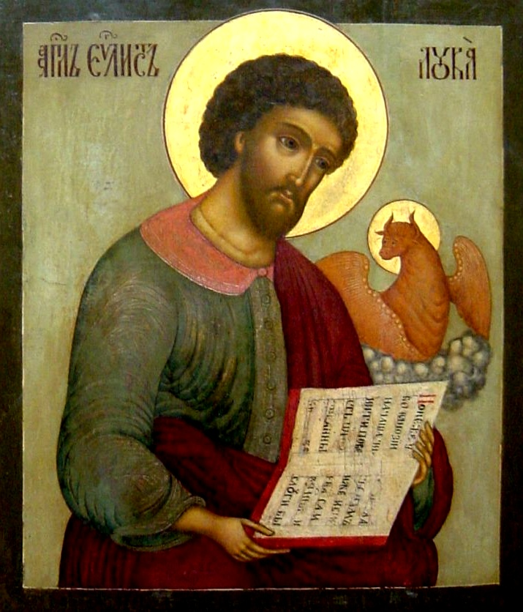
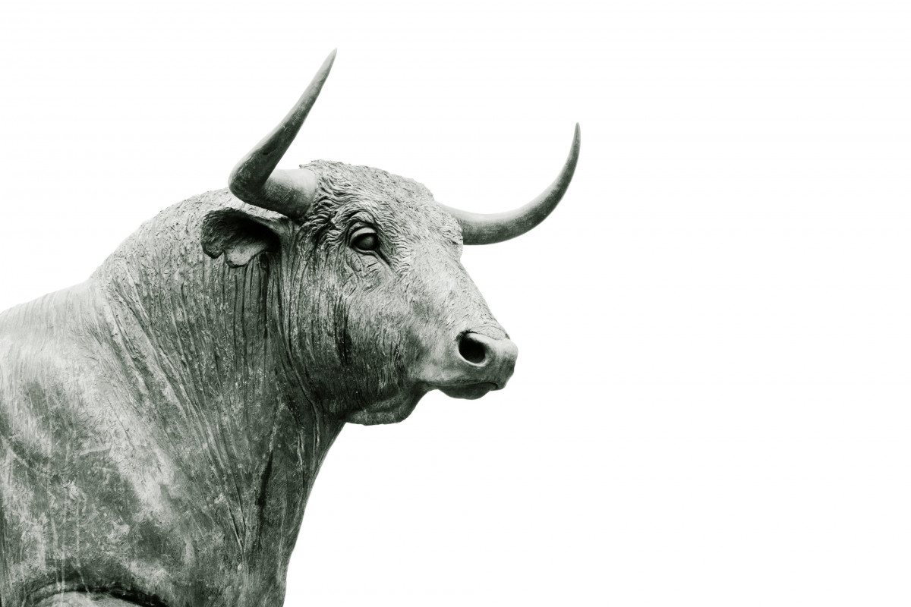
More Facts...
St Luke wrote the 3rd gospel and the acts of the apostles.
Luke never actually met Jesus but was a friend of St Paul.
St Lukes Symbol was an ox.
This Photo by Unknown author is licensed under CC BY-NC.

Slide 5
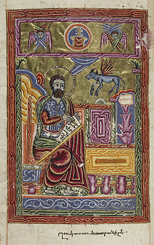
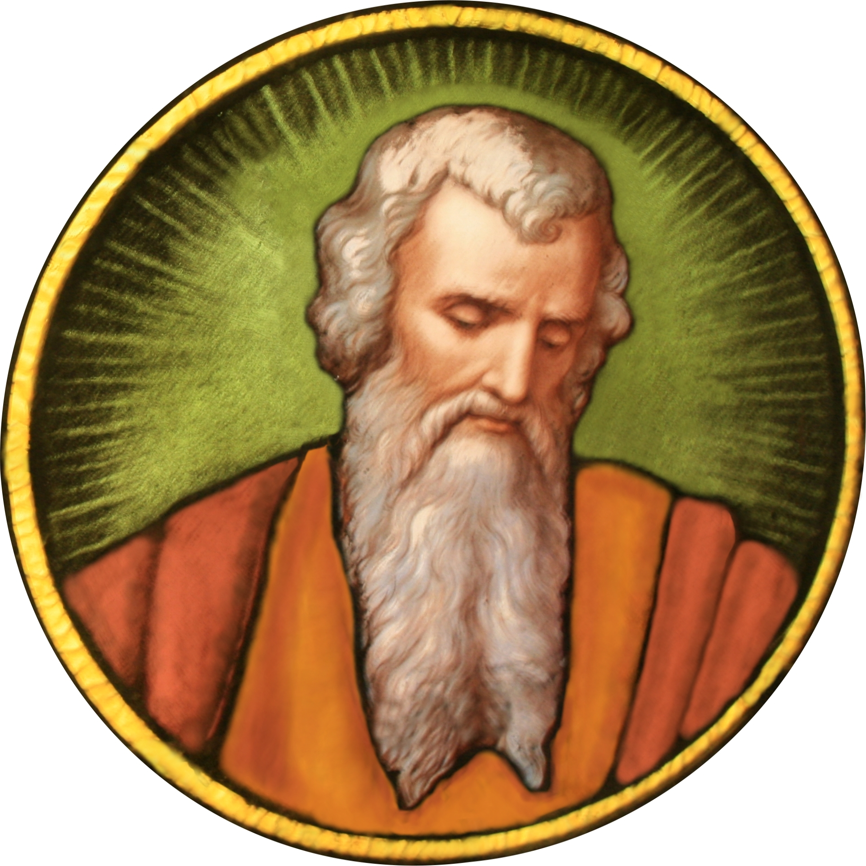
Conclusion
Reading Lukes gospel gives a good idea of his character as one who loved the poor who respected women and saw hope in everybody.

Slide 6
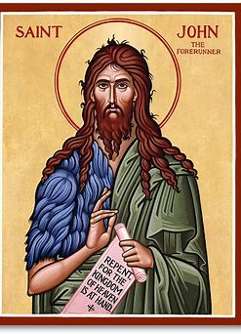
Blue House: Saint John The Baptist

Slide 7
Saint John the Baptist was a Jewish prophet who preached the imminence of God's final judgment, had several disciples and baptized a number of people.

Slide 8
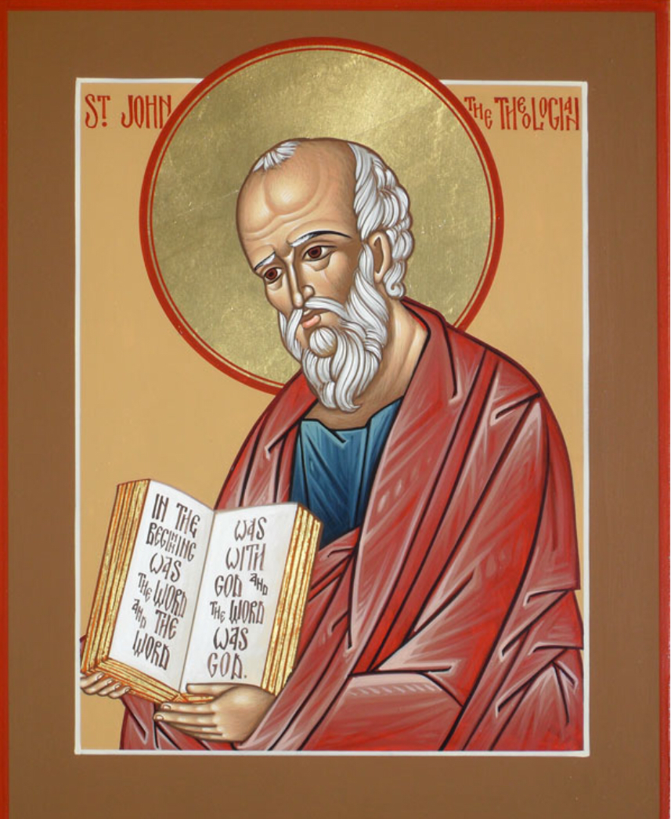
John grew up in a family of fisherman and was brought up by his mother and father , Zebedee and Salome

Slide 9
Did you know?
St.John wrote 5 books of the bible , all in the New Testament:The Gospel of John , the three epistles of John and the book of Revelation.

Slide 10
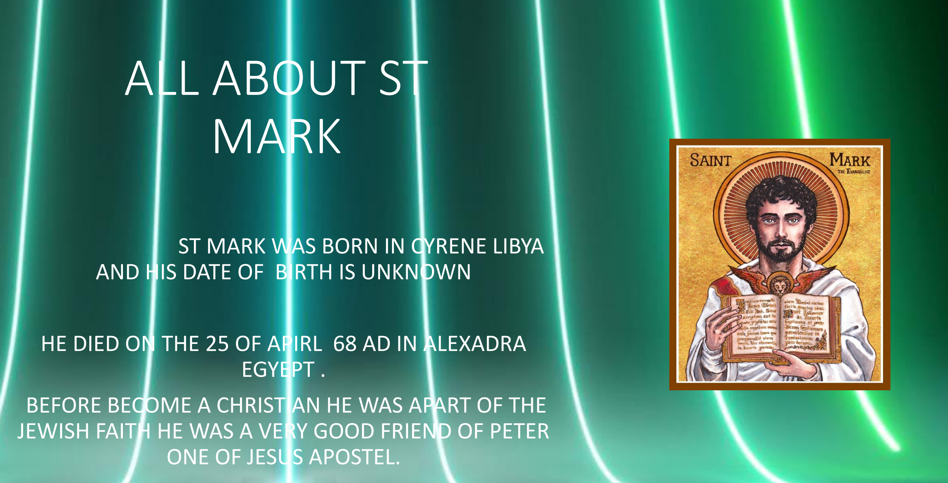

Slide 11
Who was Mark?
St Mark was the author of the gospel Mark in the bible.
Mark played a vital role in spreading the gospel as a missionary in the early church.
He is one of Jesus’ apostles.

Slide 12
Facts about Mark
St Mark was born in North Africa in 12 AD.
He died when he was 56 in 68 AD.
Mark accompanied his cousin Barnabus on the first missionary journey of the apostle Paul.
His symbol is a winged Lion
Mark is the Saint of lawyers, barristers, captives, prisoners, imprisoned people and stained glass workers.

Slide 13
Mark’s gospel
Mark was the earliest gospel written.
His gospel is the shortest gospel in the bible.
The gospel of Mark is describing Jesus’ death, resurrection and ascension.
The word ‘immediately’ appears 41 times in the gospel of Mark.

Slide 14
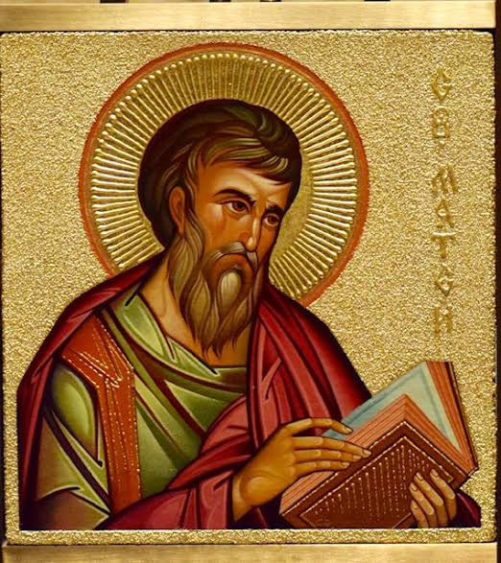
Saint Matthew

Slide 15
Matthew the Apostle, also known as Saint Matthew and as Levi, was, according to the New Testament, one of the twelve apostles of Jesus.
In the New Testament he was recorded as one of the disciples, he followed Jesus, and was one of the witnesses of the Ascension of Jesus.
Matthew was present at several of the most important events in Jesus' life. He wrote the Gospel of Matthew to tell about Jesus' life and his understanding of who Jesus was.
St. Matthew accompanied Jesus from the time he called him until Jesus was crucified. He saw Jesus after he was resurrected from the dead, and he witnessed Jesus' ascension into heaven

